Slide 1
Online Learning Development

Slide 2
Modules
Training Content
Training Schedules
Training Material
Projects Delivery

Slide 3
Models
User
Courses
Projects

Slide 4
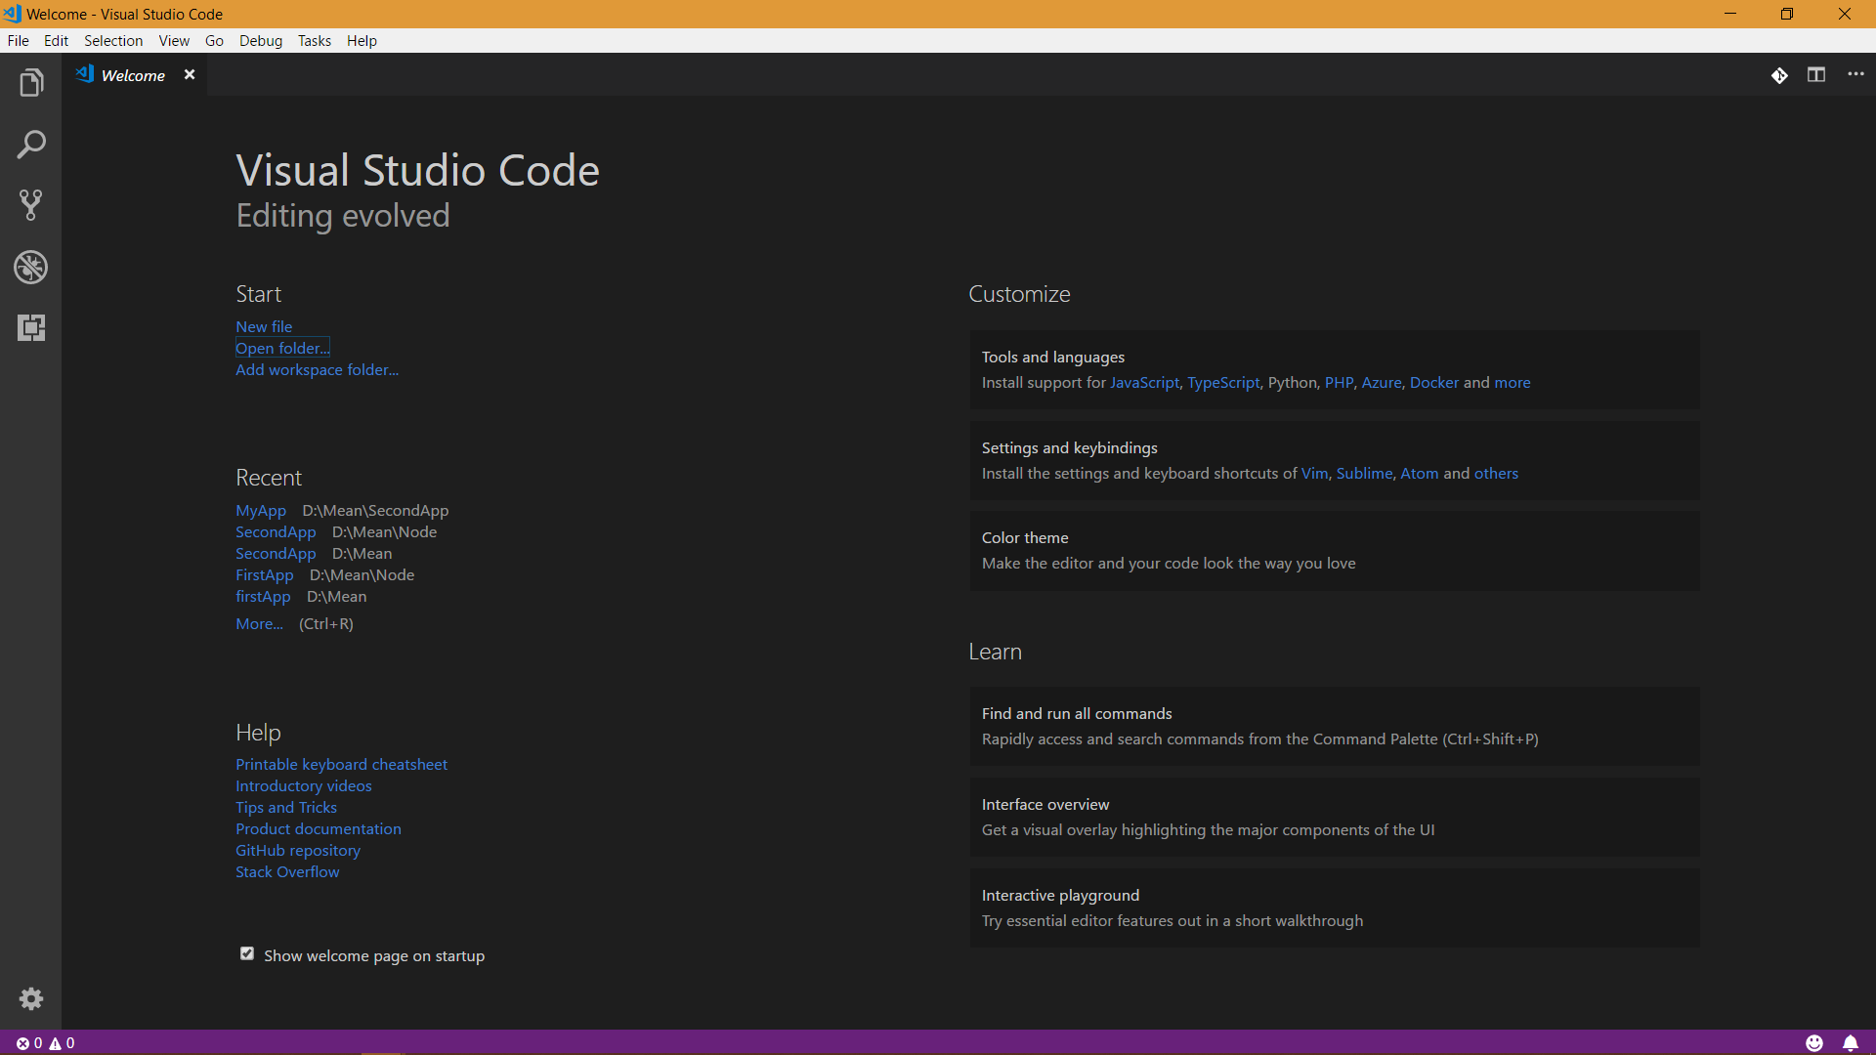
Notes:
Open Visual Studio Code and click on Open Project

Slide 5
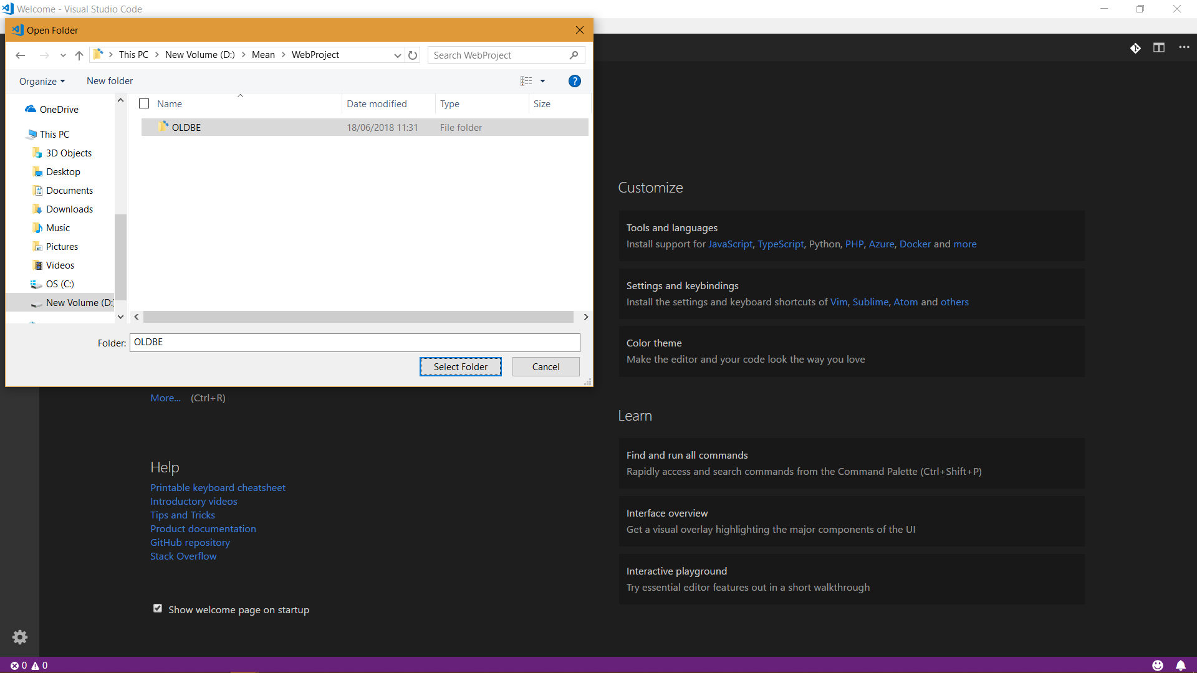
Notes:
Select the project folder

Slide 6
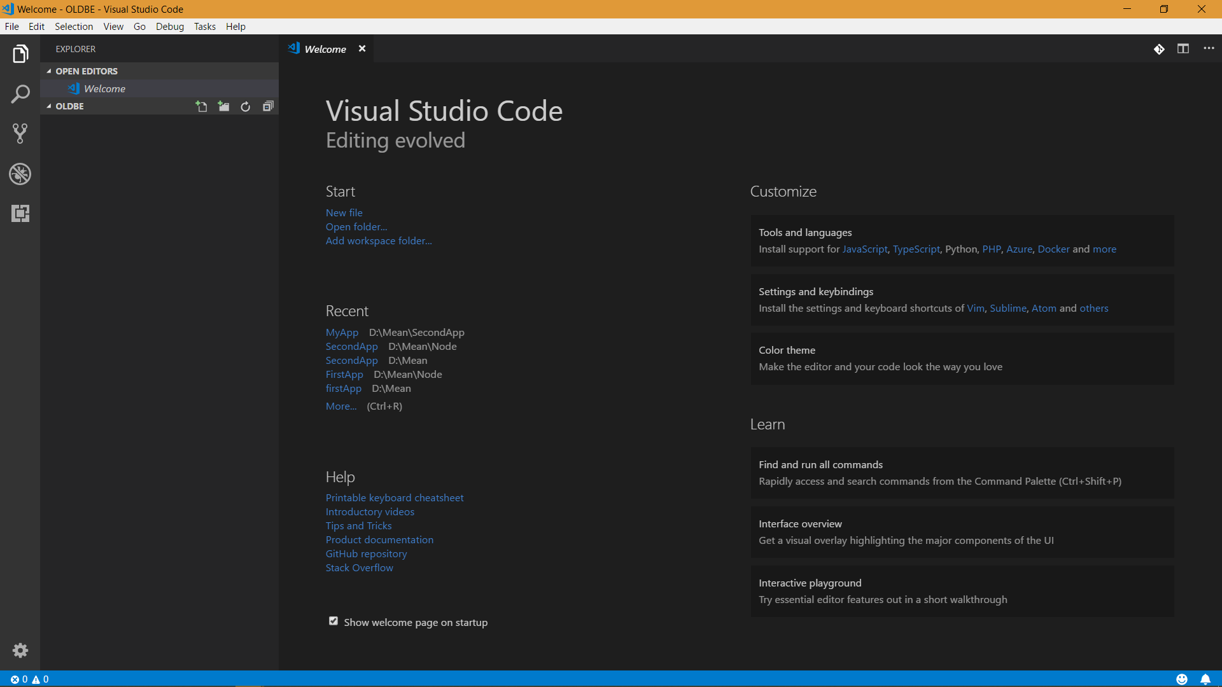

Slide 7
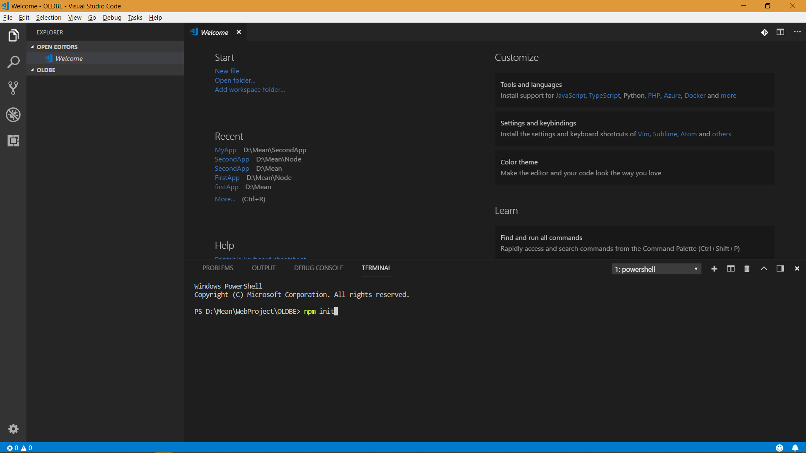
Notes:
Press ctrl + ` for Terminal to open
And type npm init to initialize the folder

Slide 8
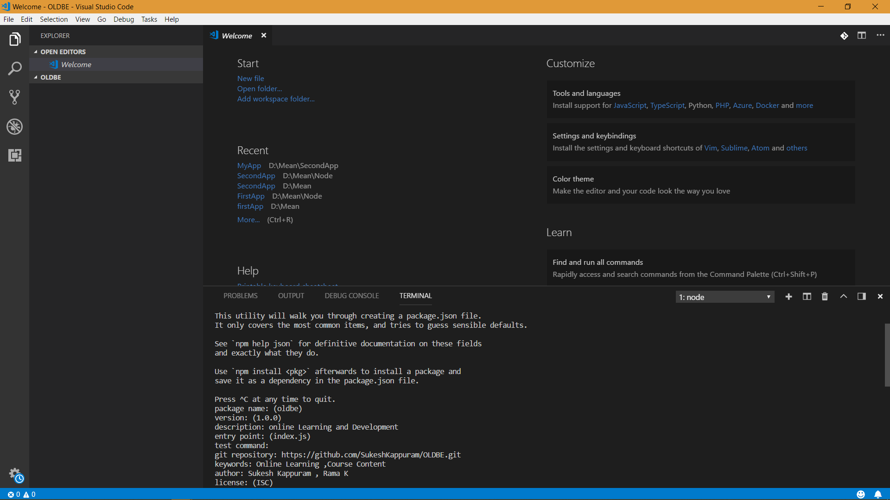
Notes:
Give the required details

Slide 9
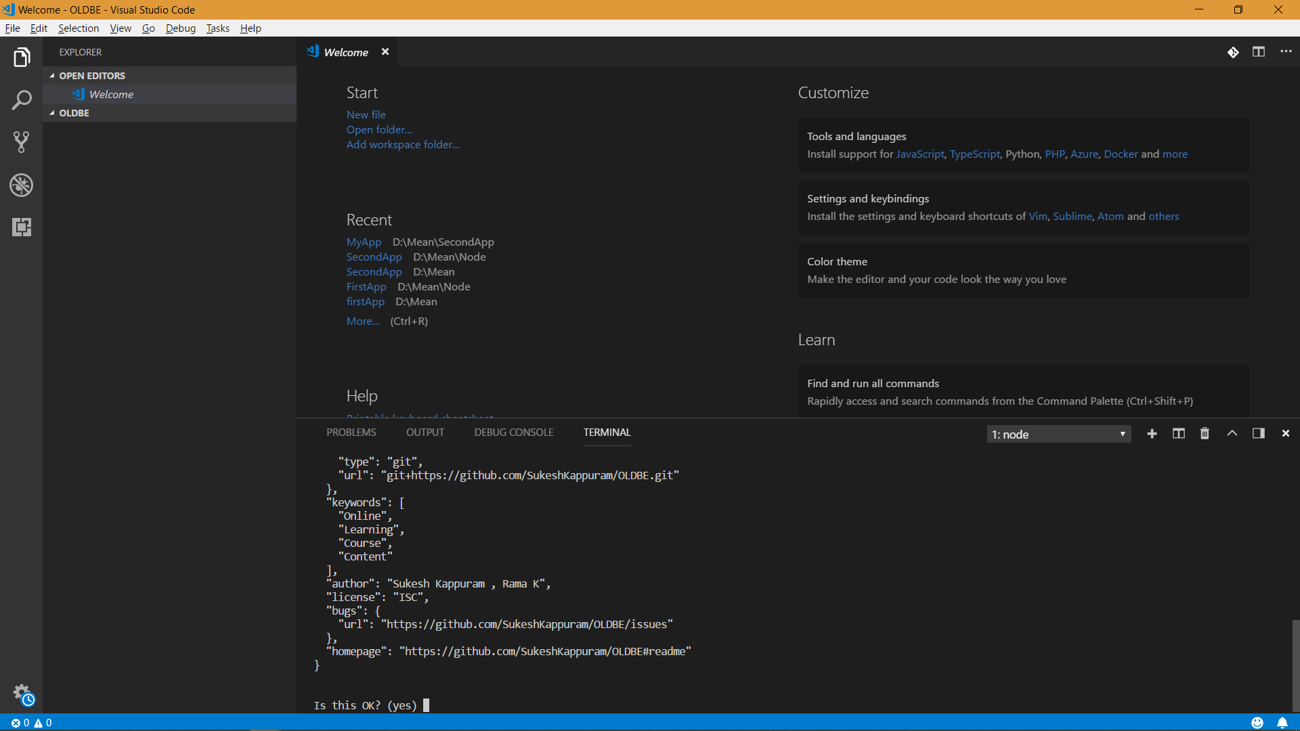
Notes:
Review and click on yes

Slide 10
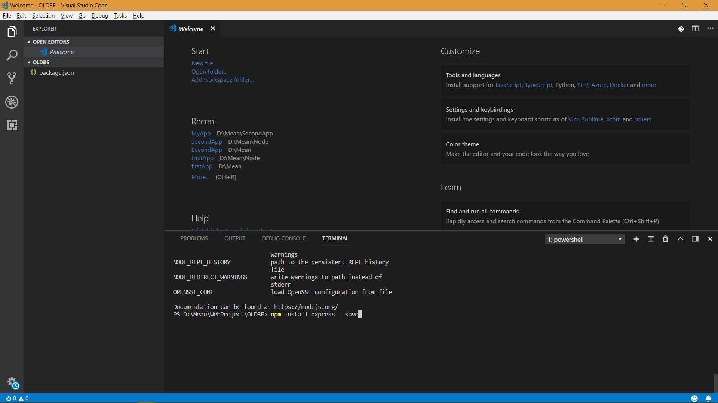
Notes:
Install express

Slide 11
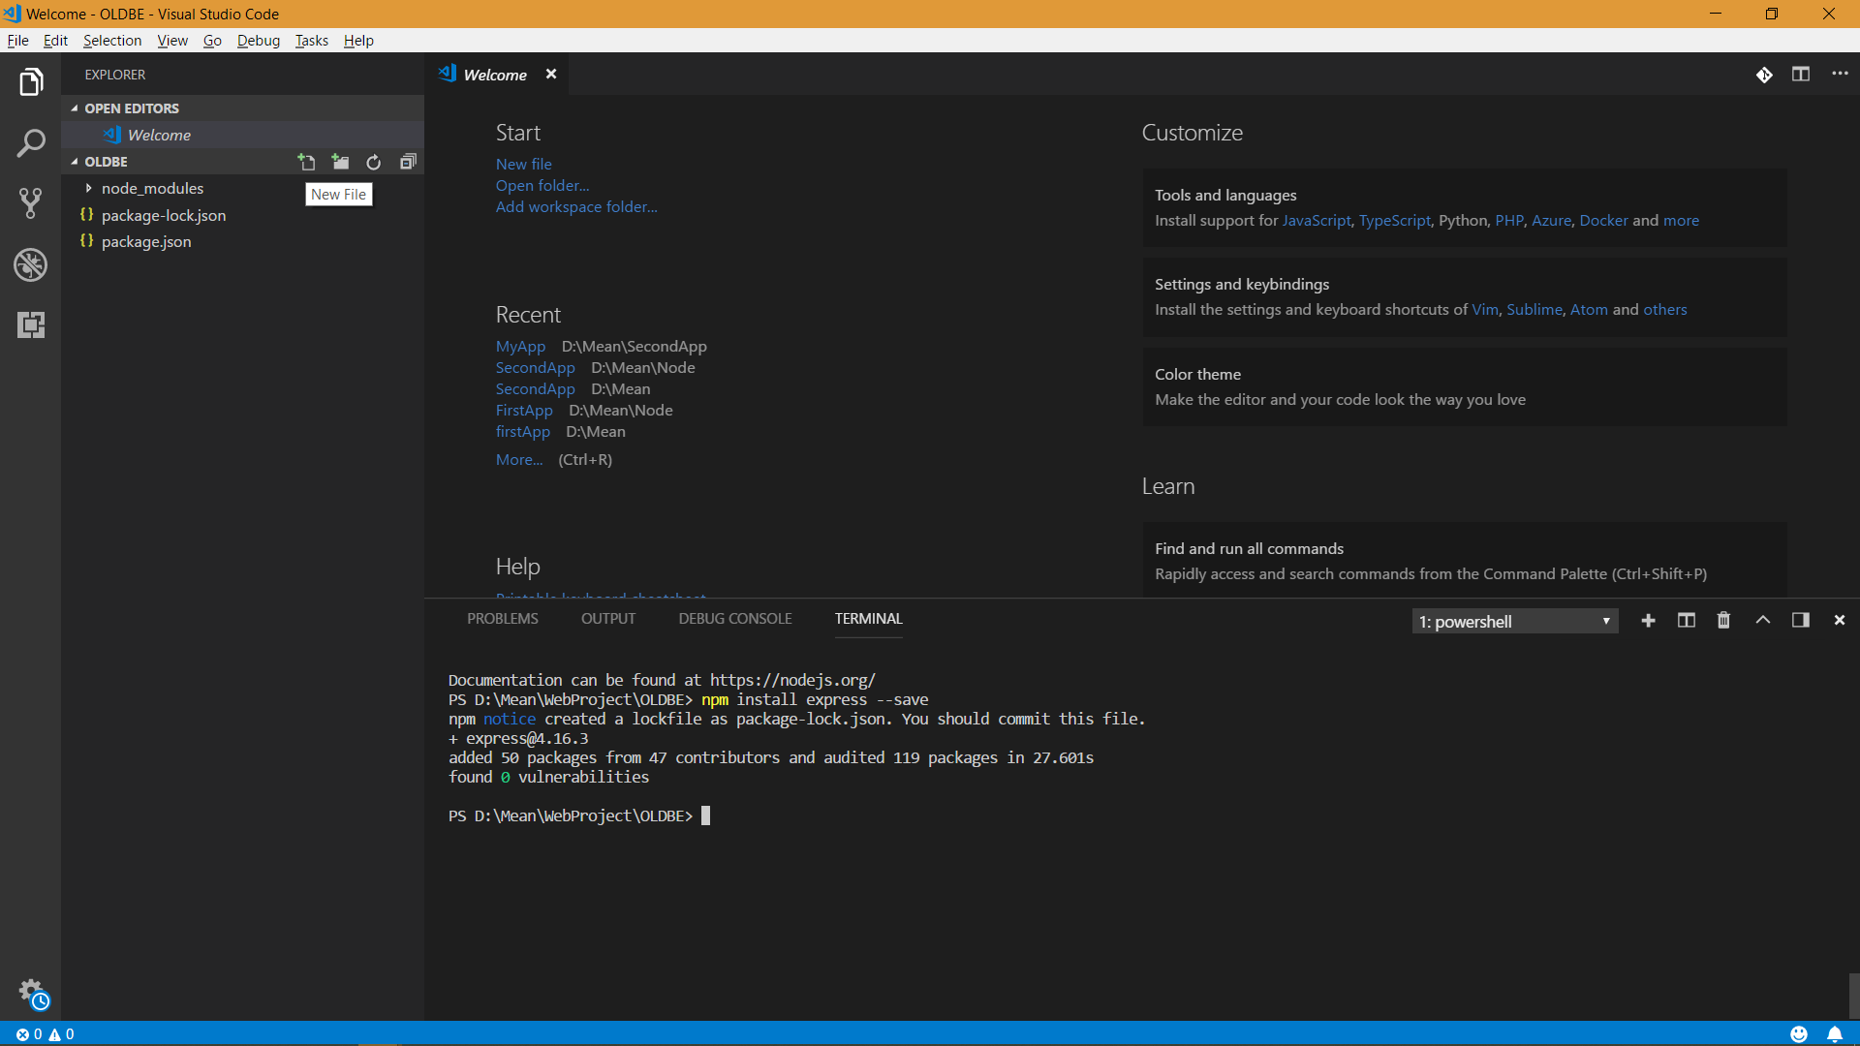
Notes:
Create New File name it as app.js

Slide 12
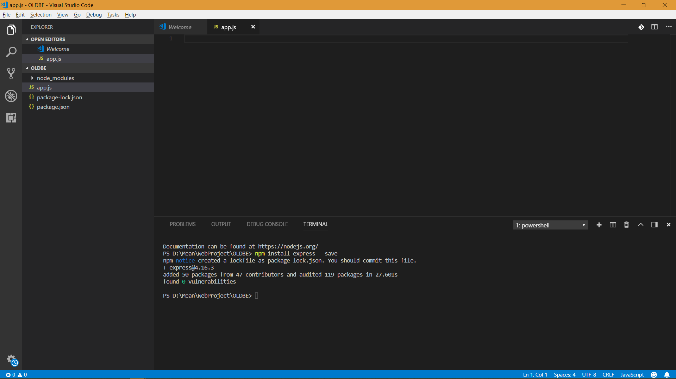

Slide 13
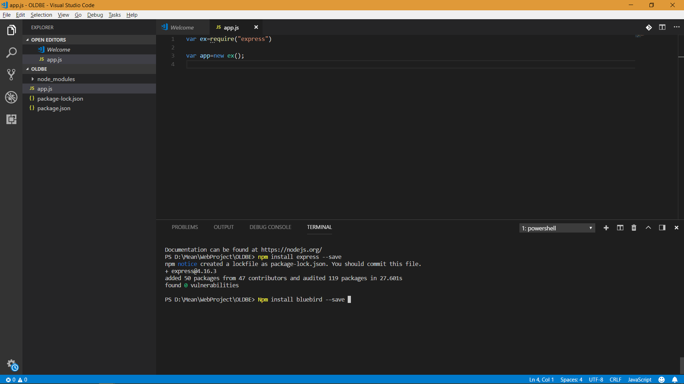
Notes:
Install blue bird

Slide 14
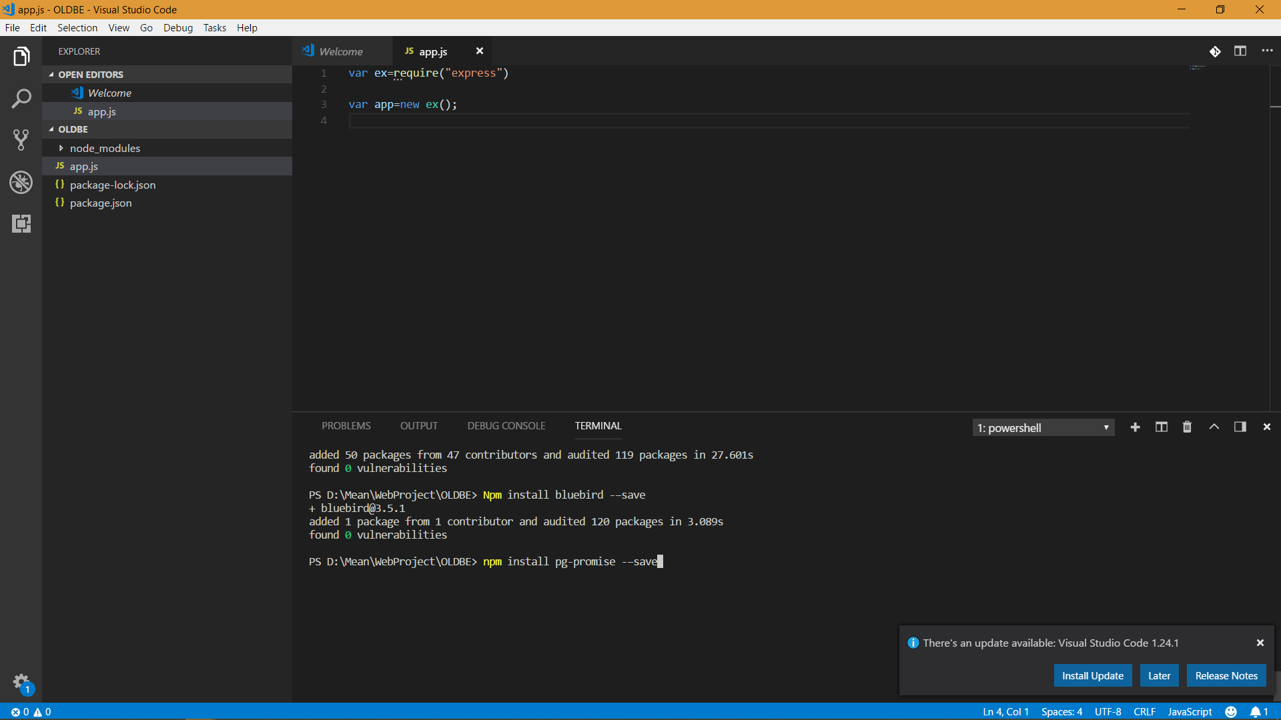
Notes:
Install Pg-Promise

Slide 15

Notes:
Install Body Parser

Slide 16
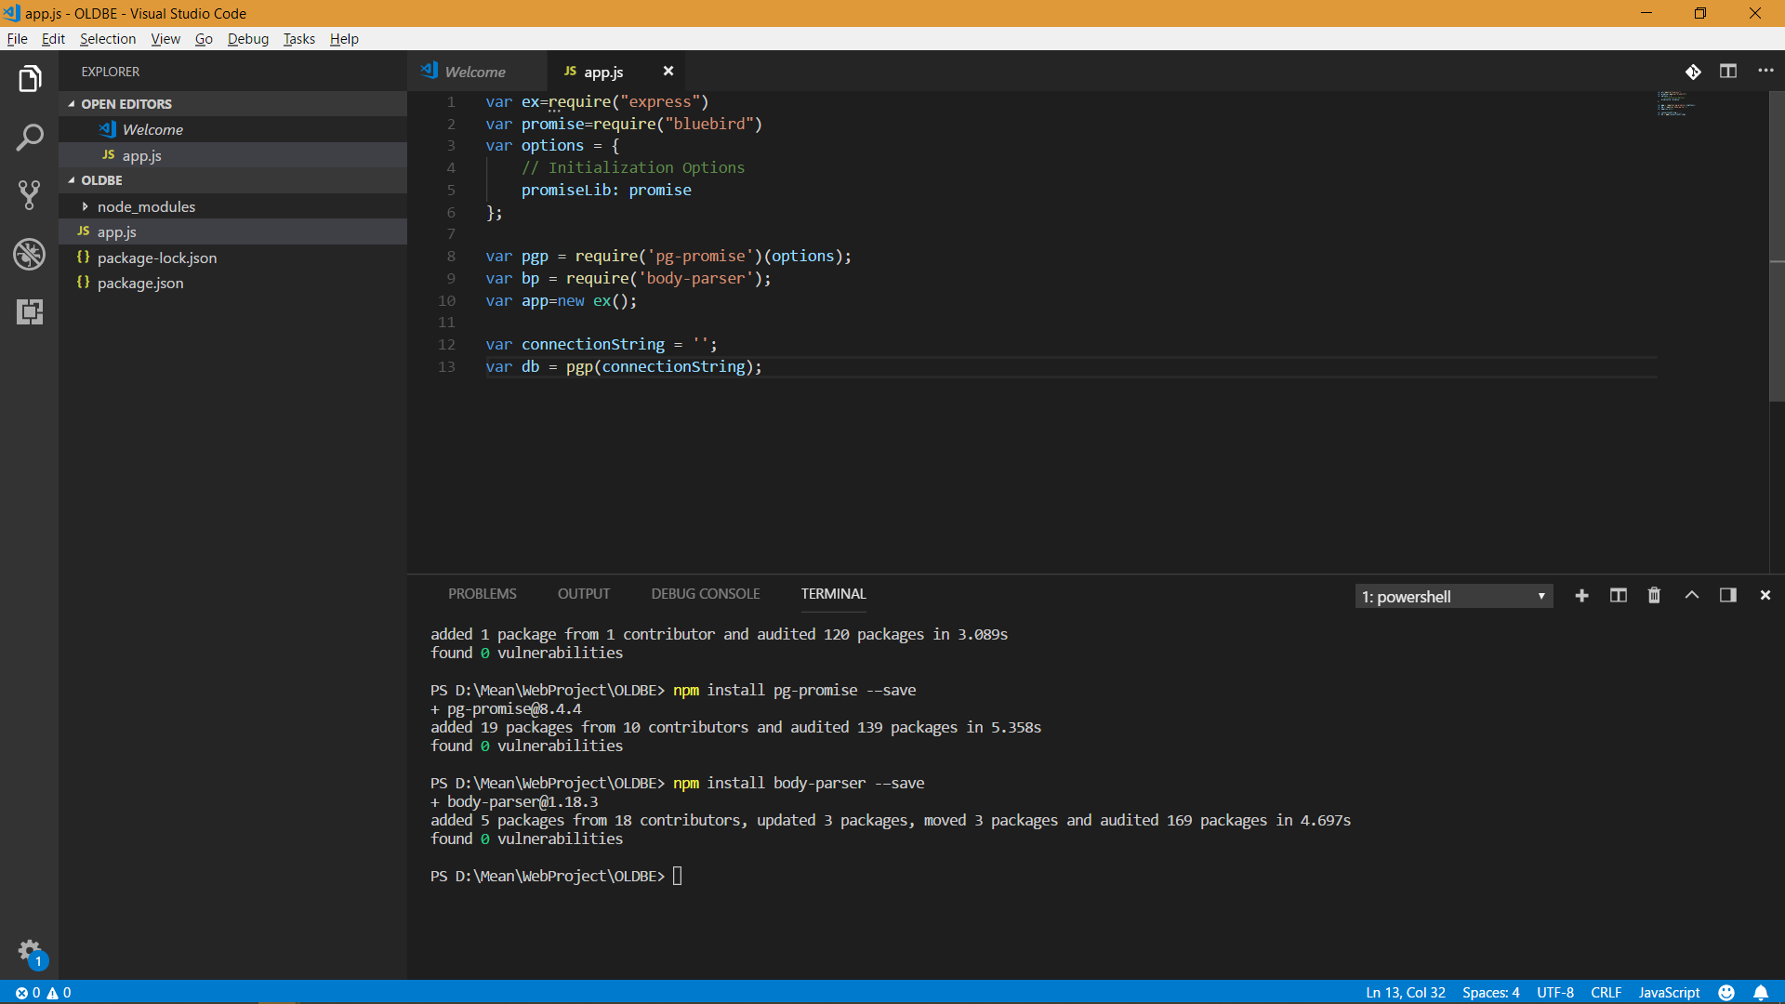
Notes:
Initialize Variables

Slide 17
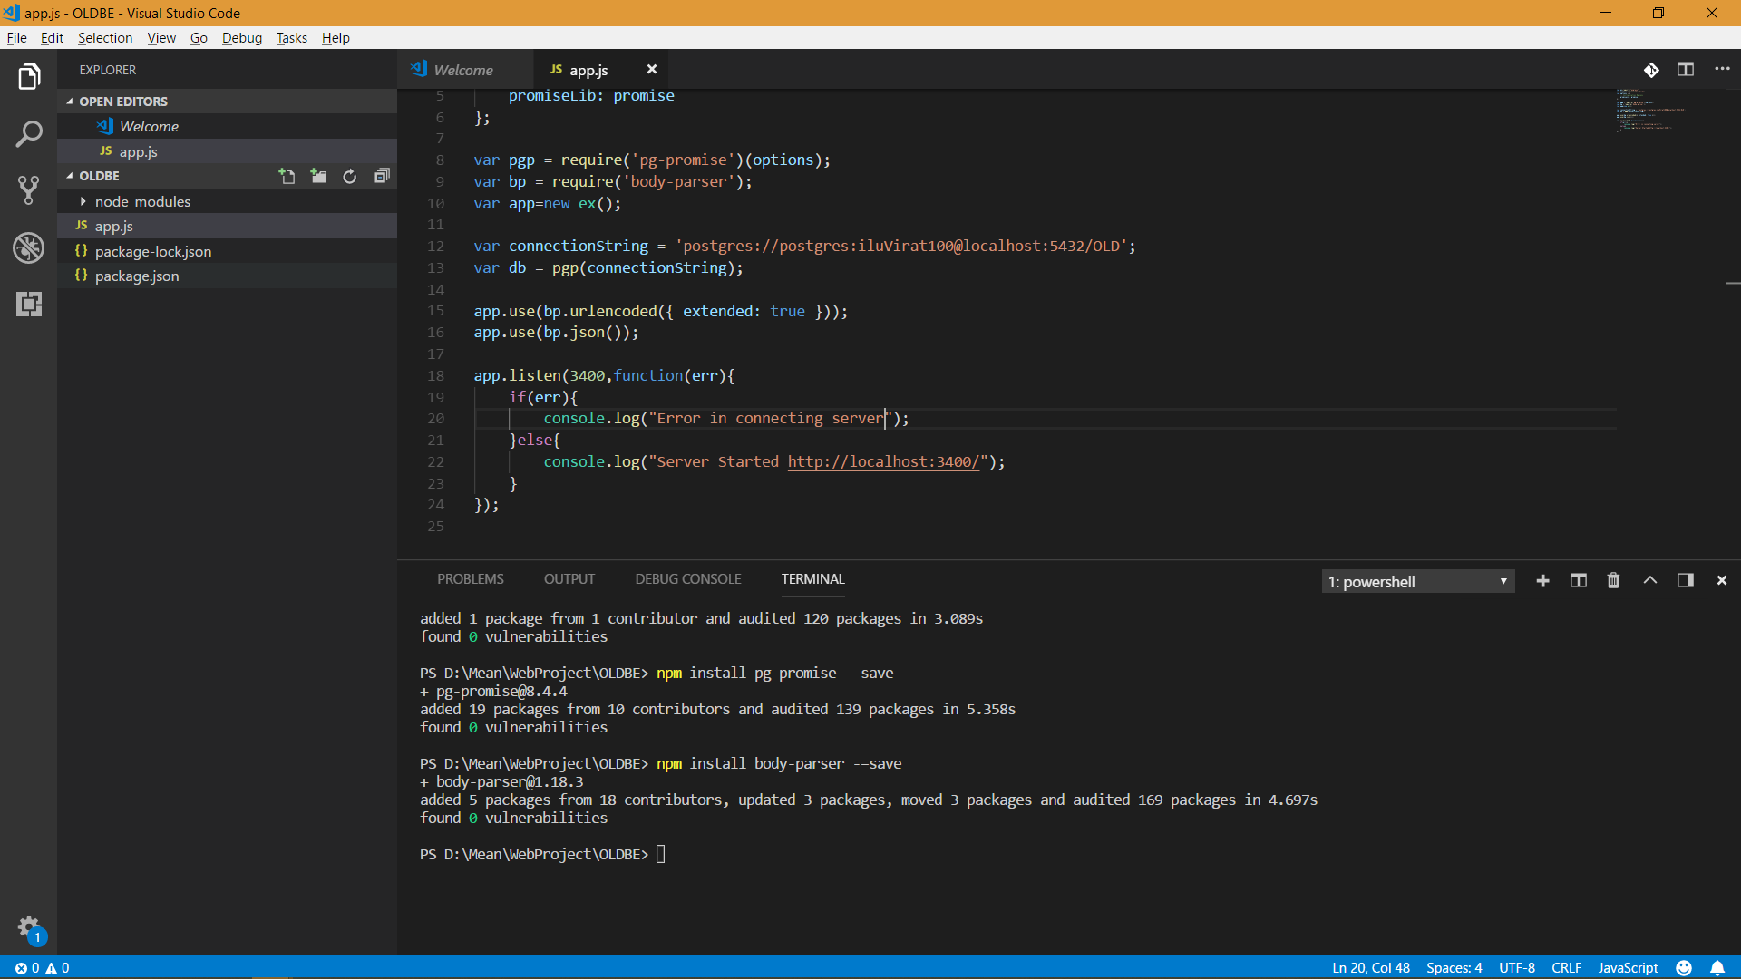
Notes:
Add Listener port

Slide 18
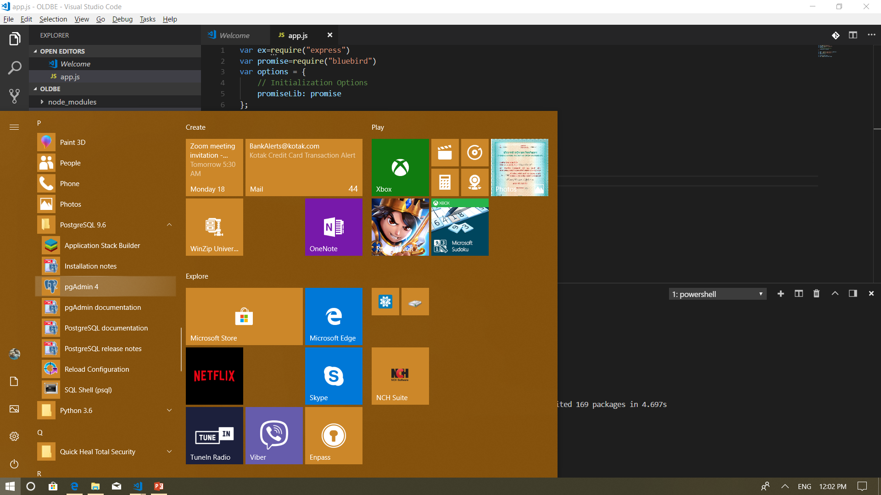
Notes:
Open Postgre SQL

Slide 19
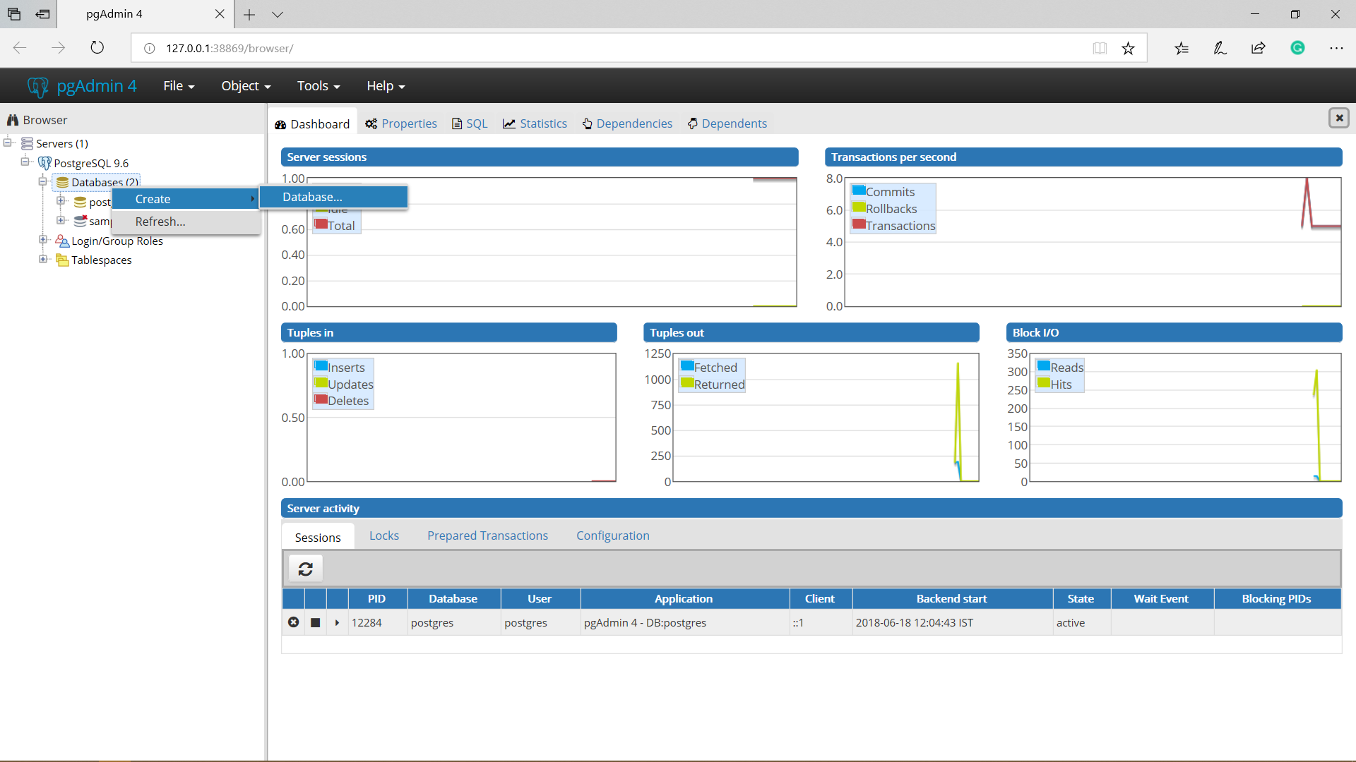
Notes:
Create new Database

Slide 20
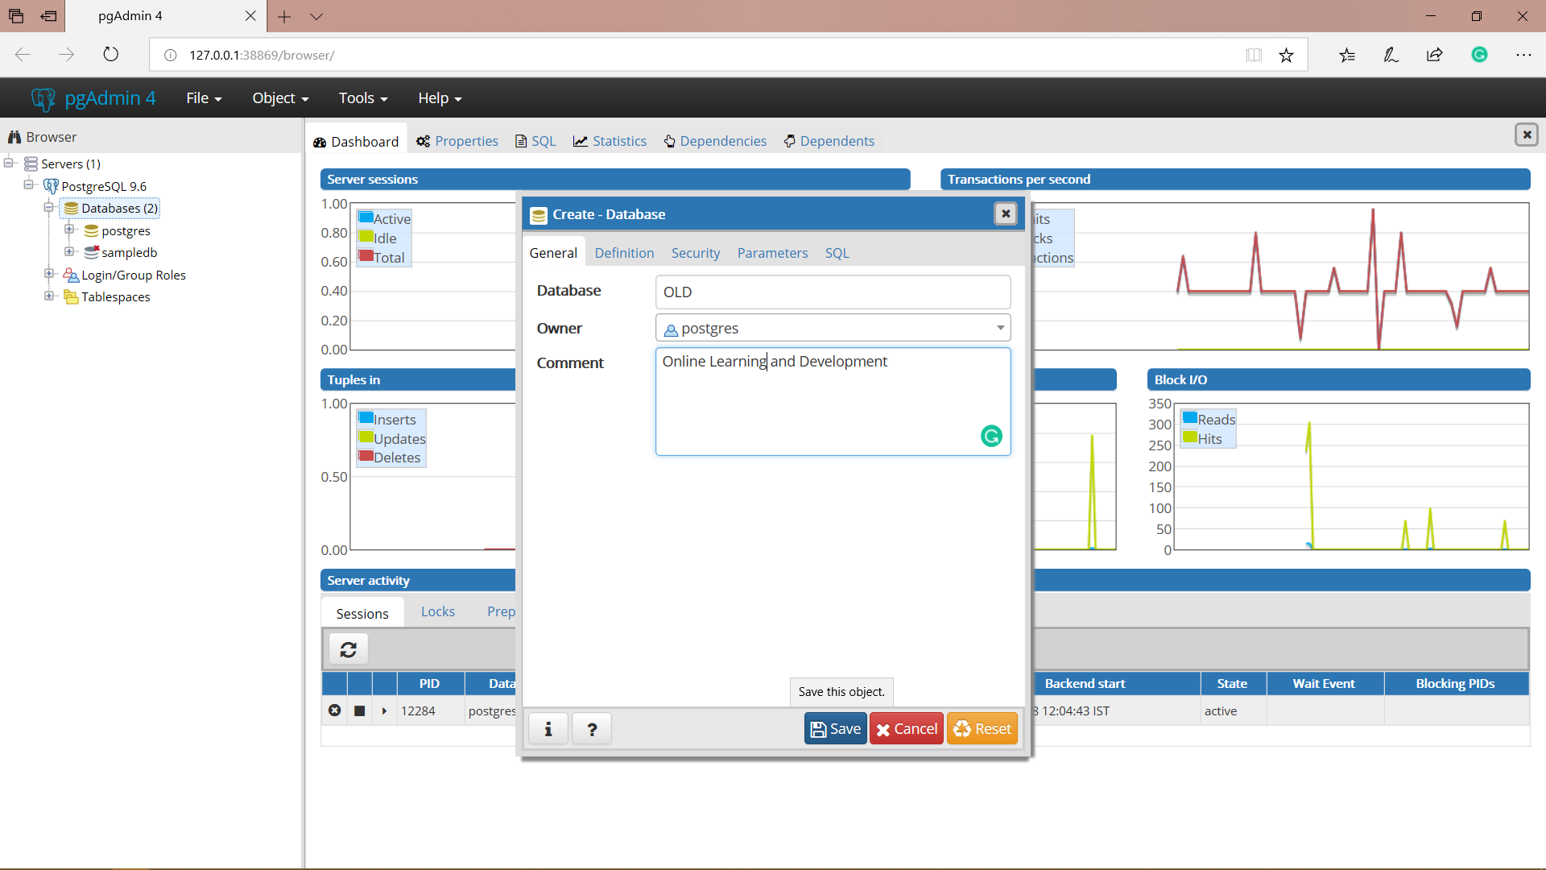
Notes:
Give required details and click save

Slide 21
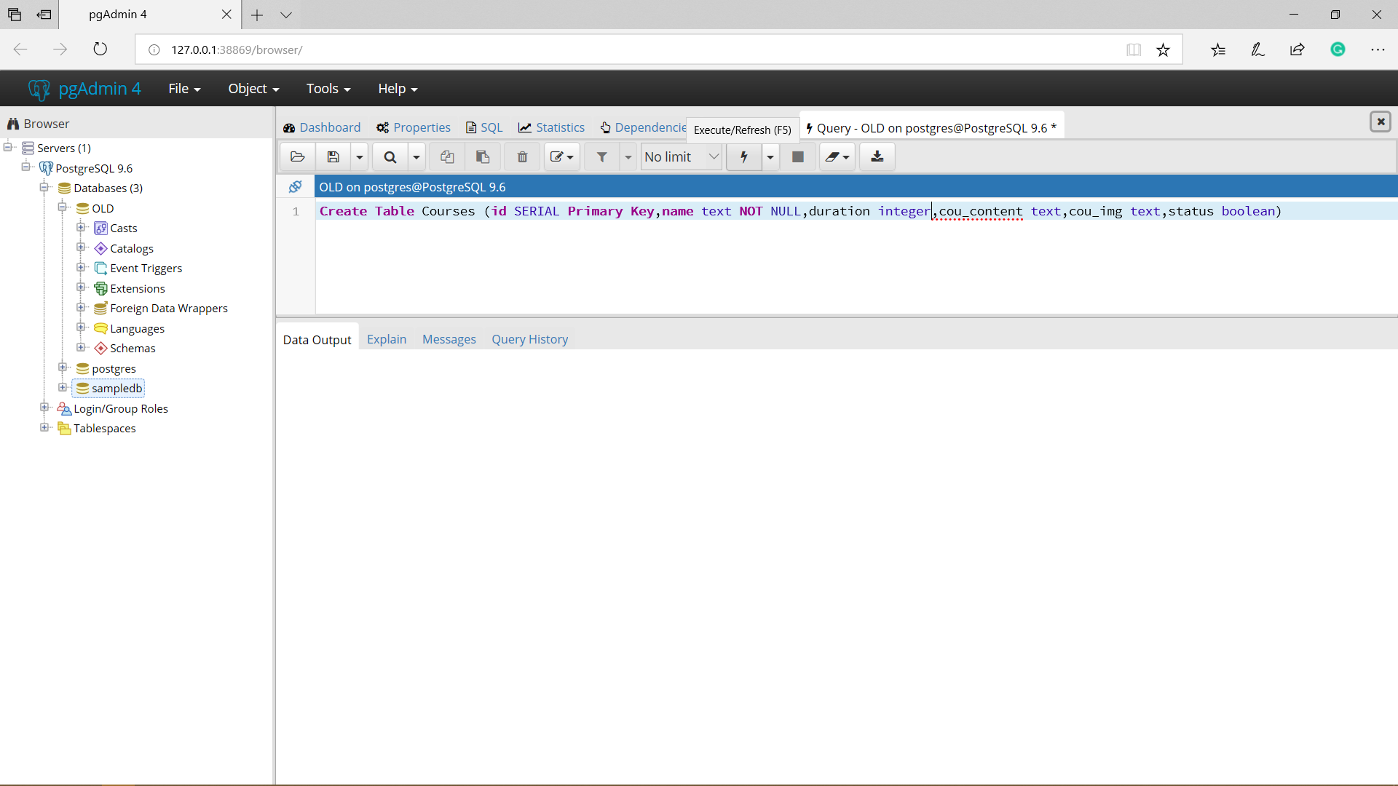

Slide 22

Notes:
Query: create table Courses(id serial primary key,name text NOT NULL,duration integer,cou_content text,cou_img text,status boolean)

Slide 23
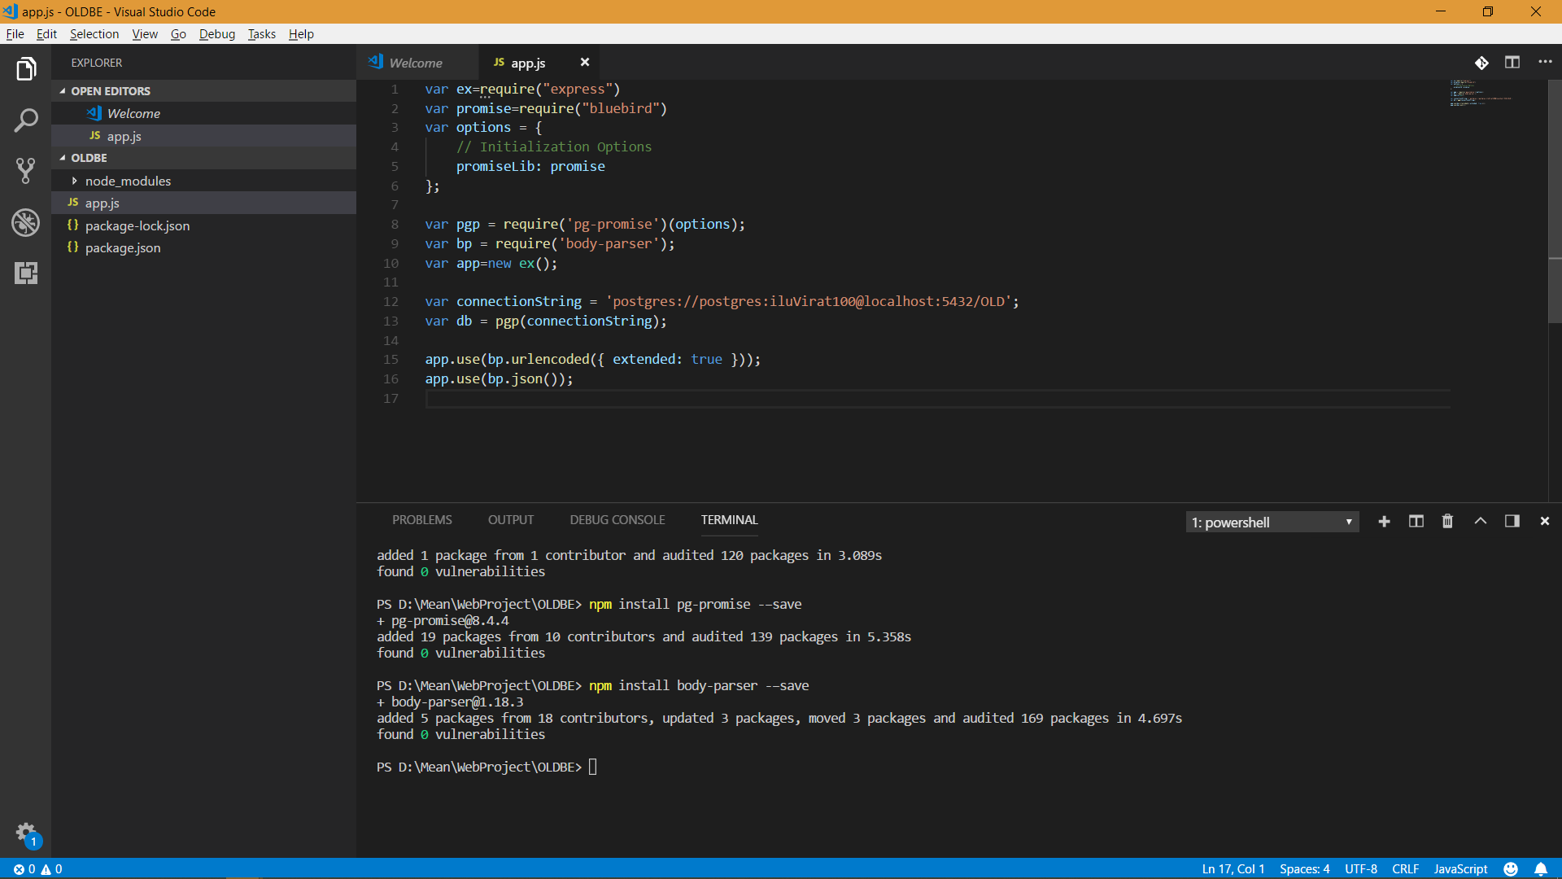
Notes:
Set the connection String

Slide 24
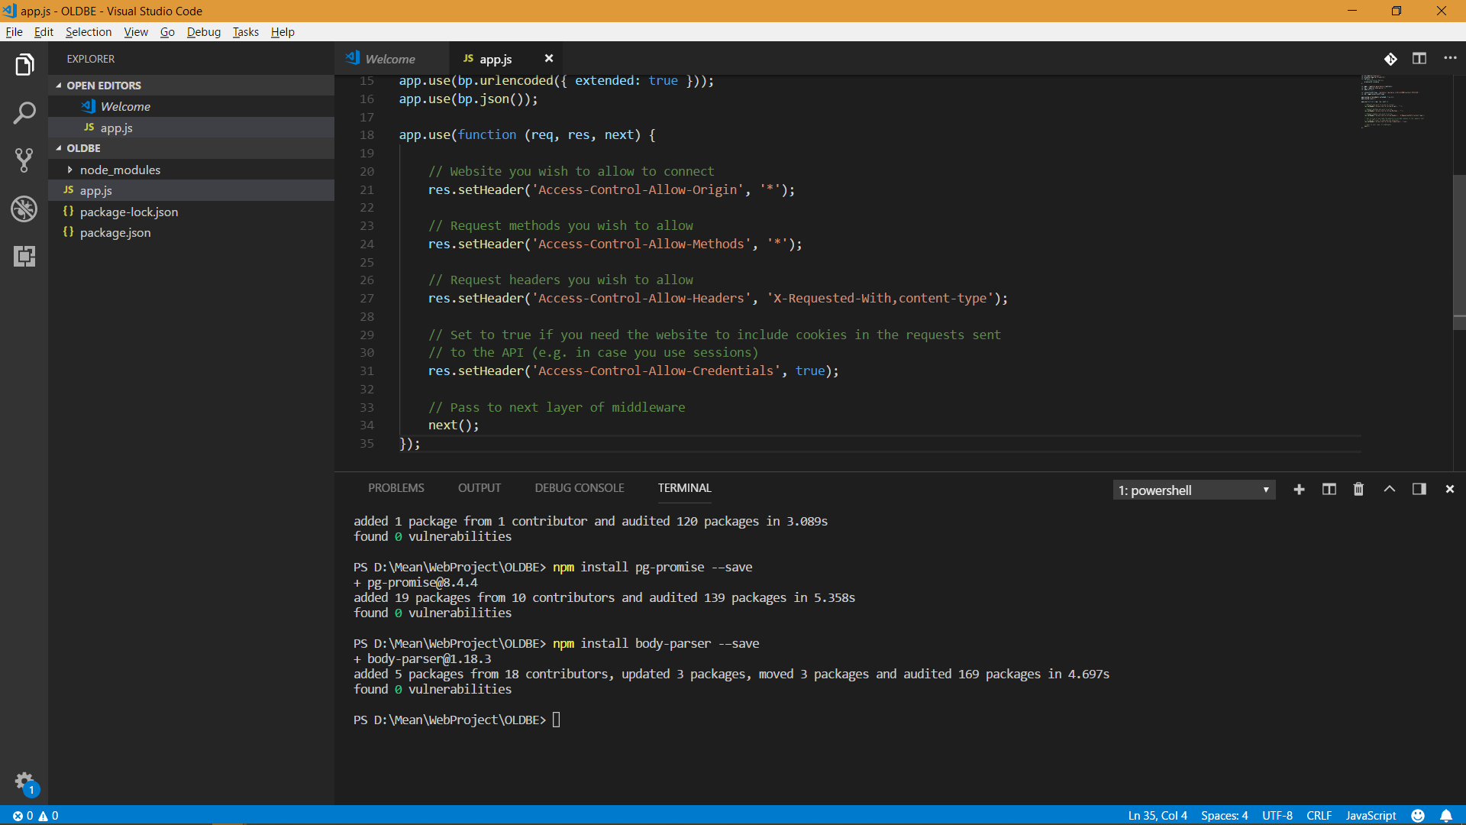
Notes:
Set up Headers

Slide 25
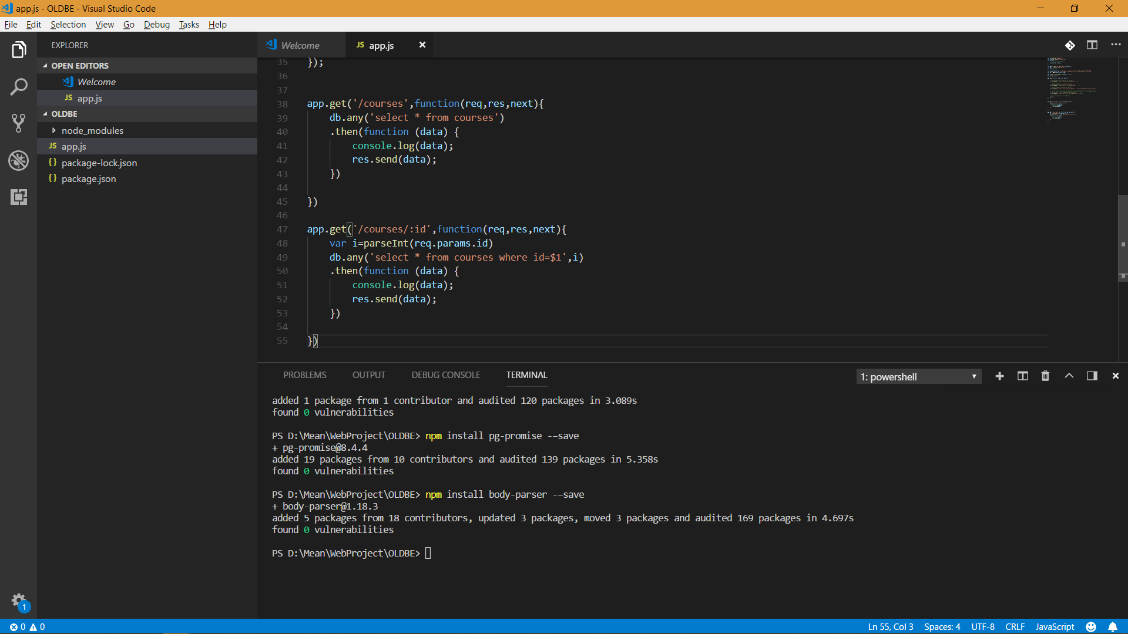
Notes:
Code the get methods

Slide 26
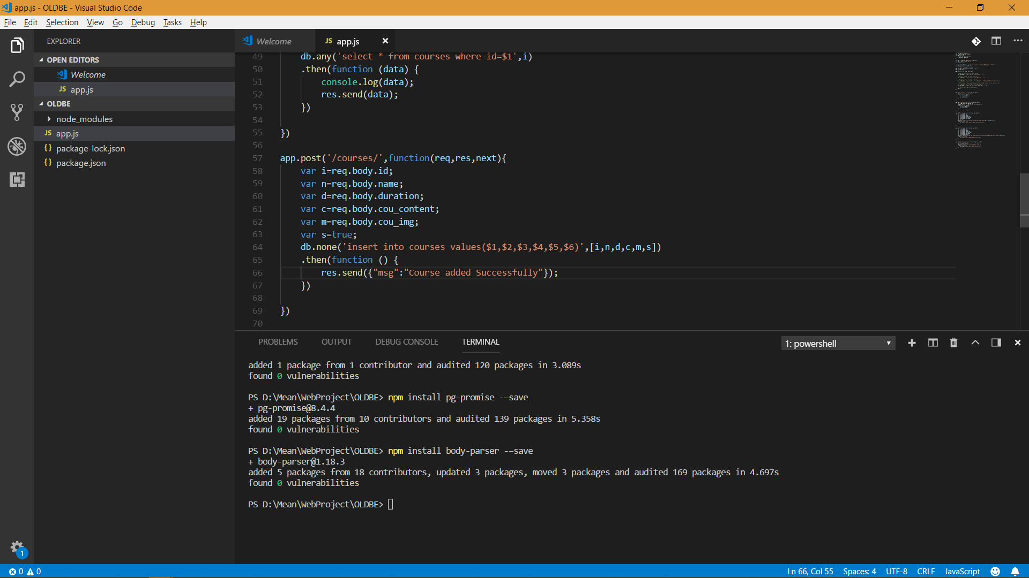
Notes:
Add create method

Slide 27
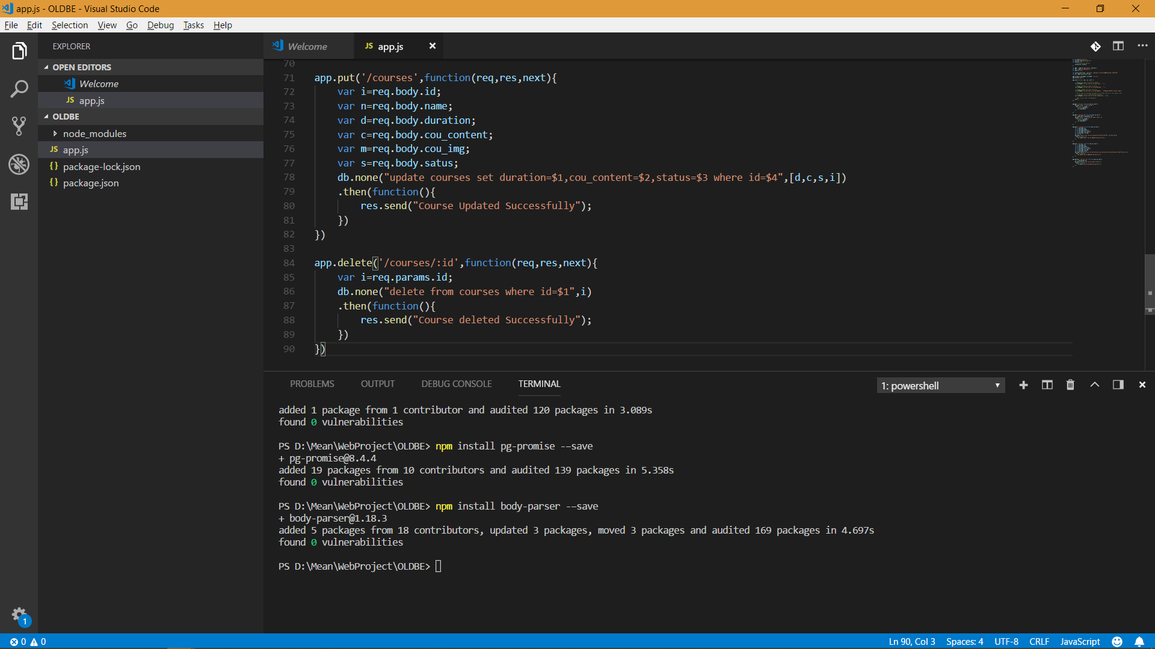
Notes:
Add update and delete methods

Slide 28
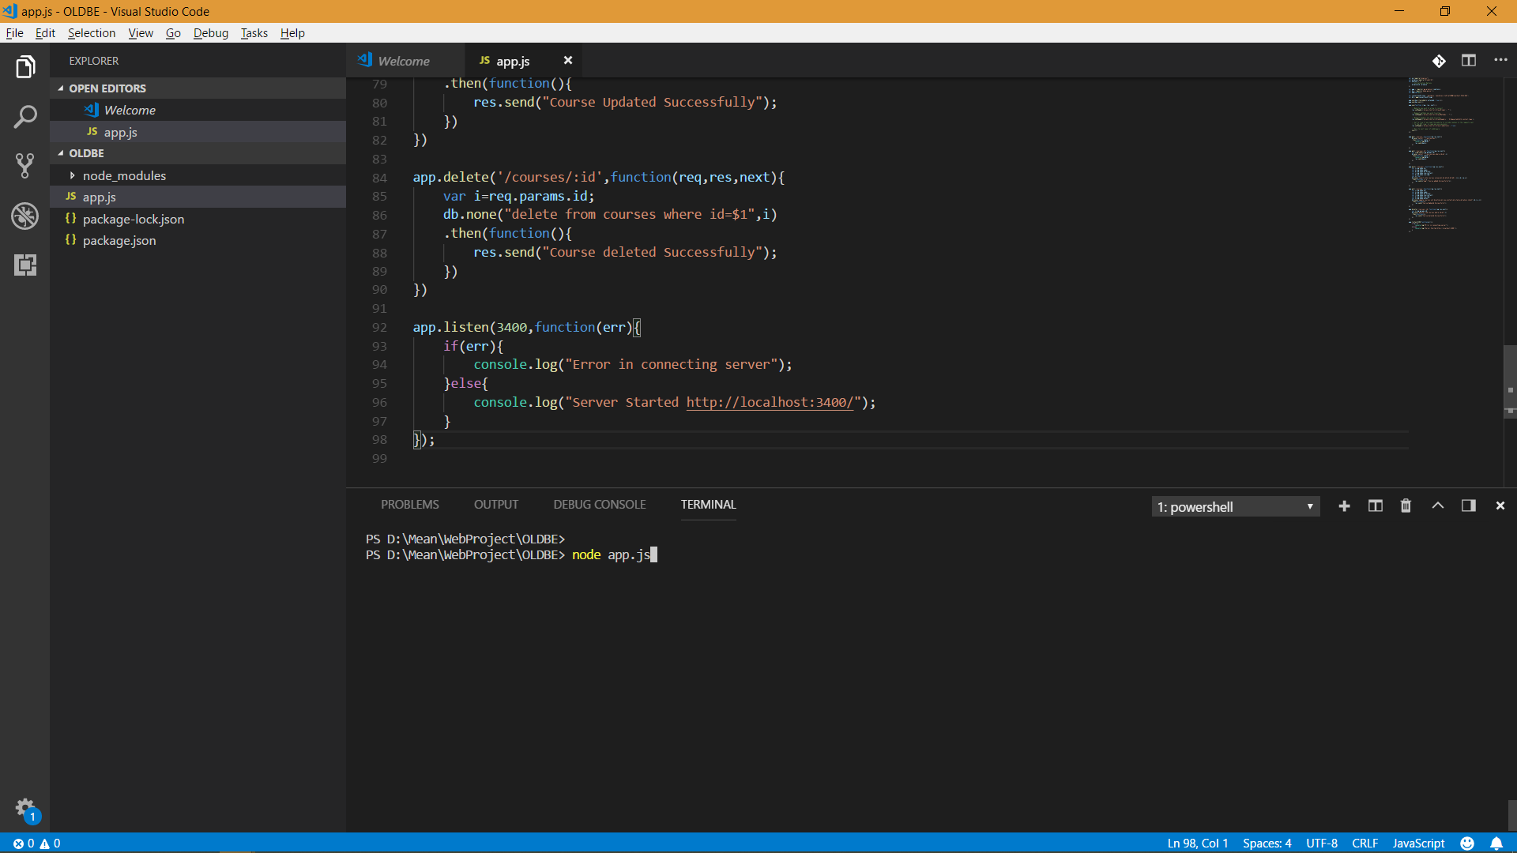
Notes:
Run Server using app.js

Slide 29


Slide 30
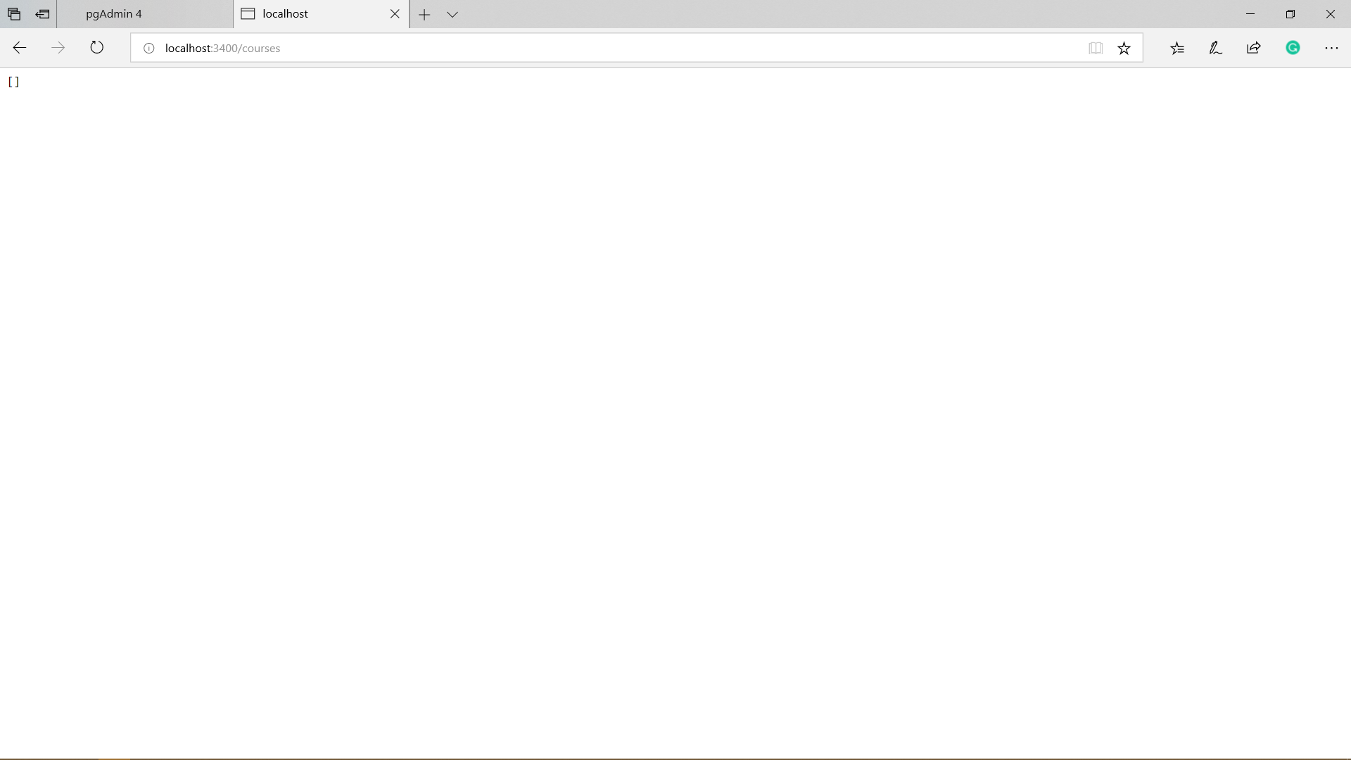
Notes:
Review your data

Slide 31
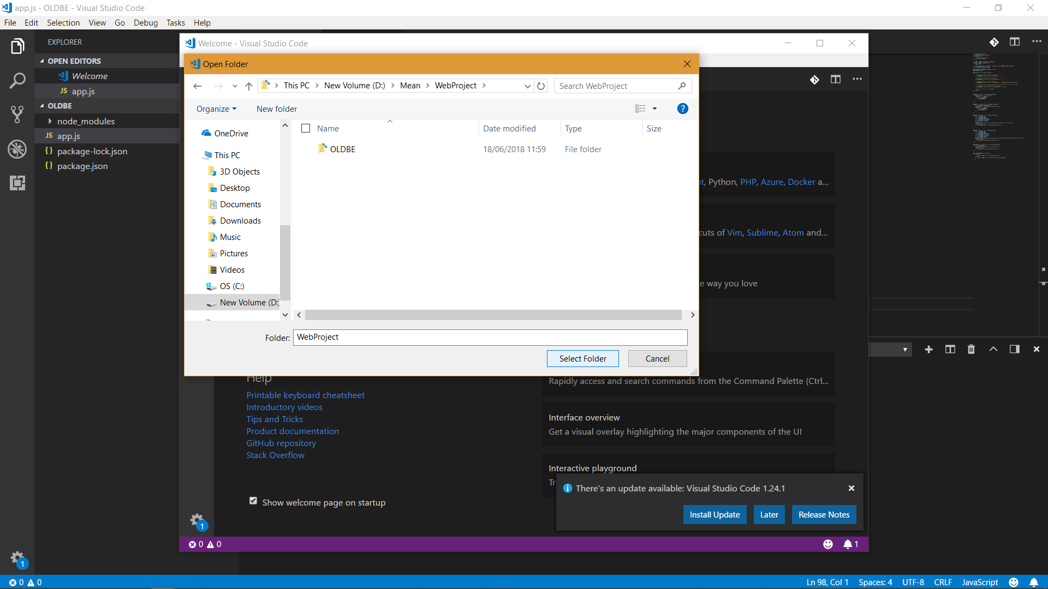
Notes:
Open Project Folder and press ctrl and ` to open terminal

Slide 32
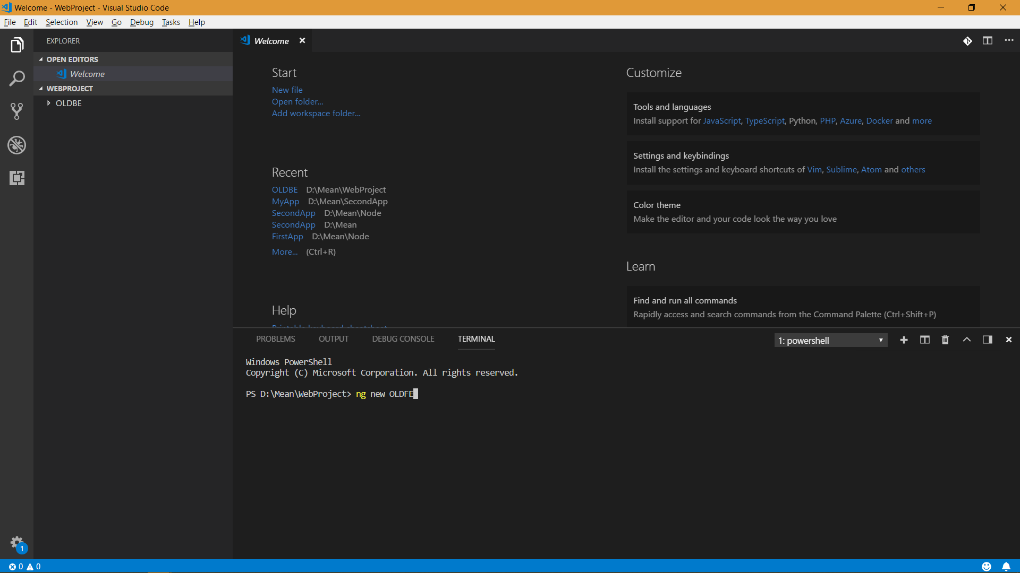
Notes:
Create new angular app

Slide 33
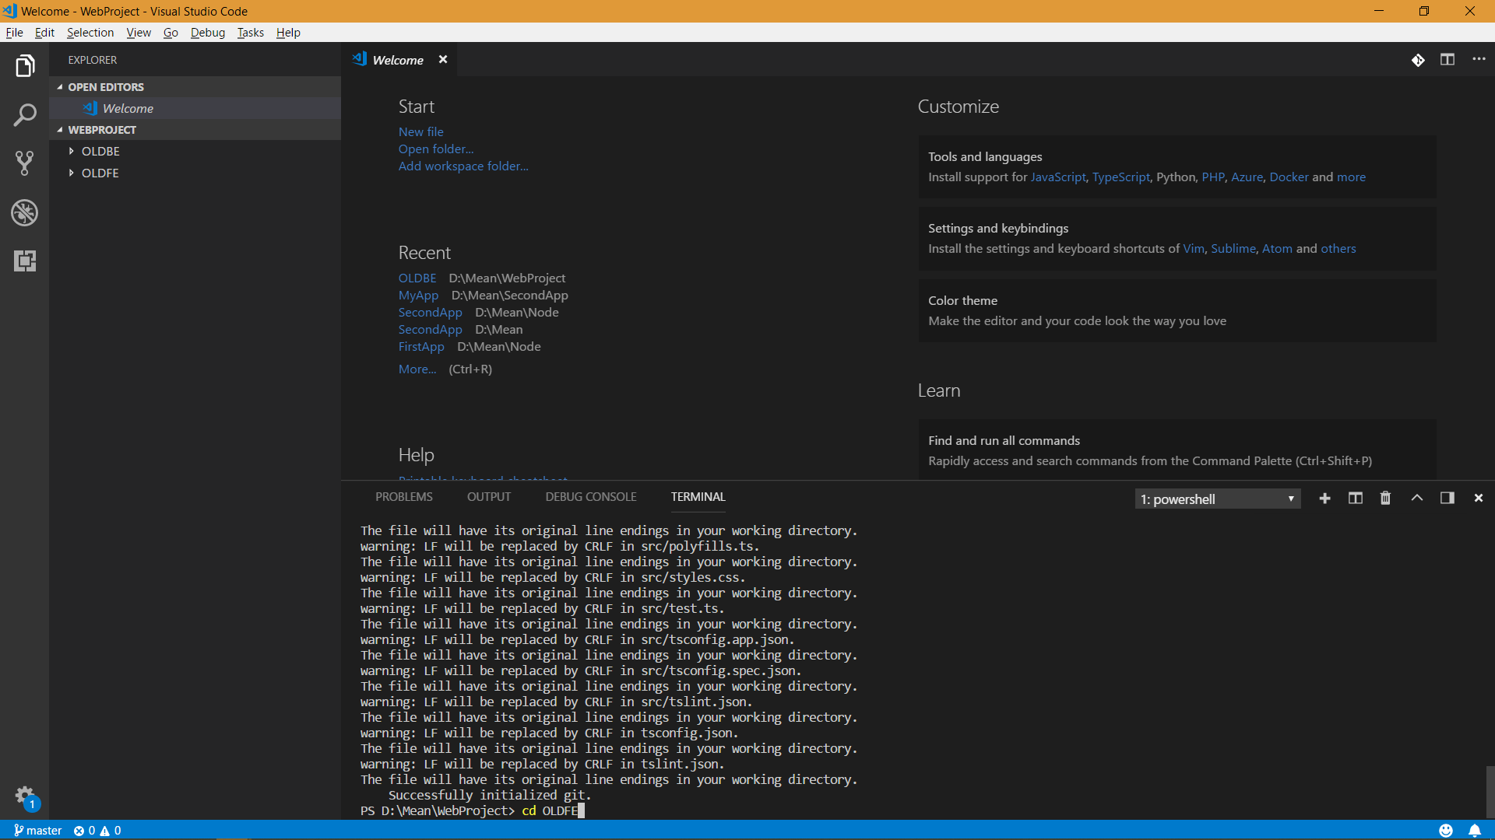
Notes:
Move to app folder

Slide 34
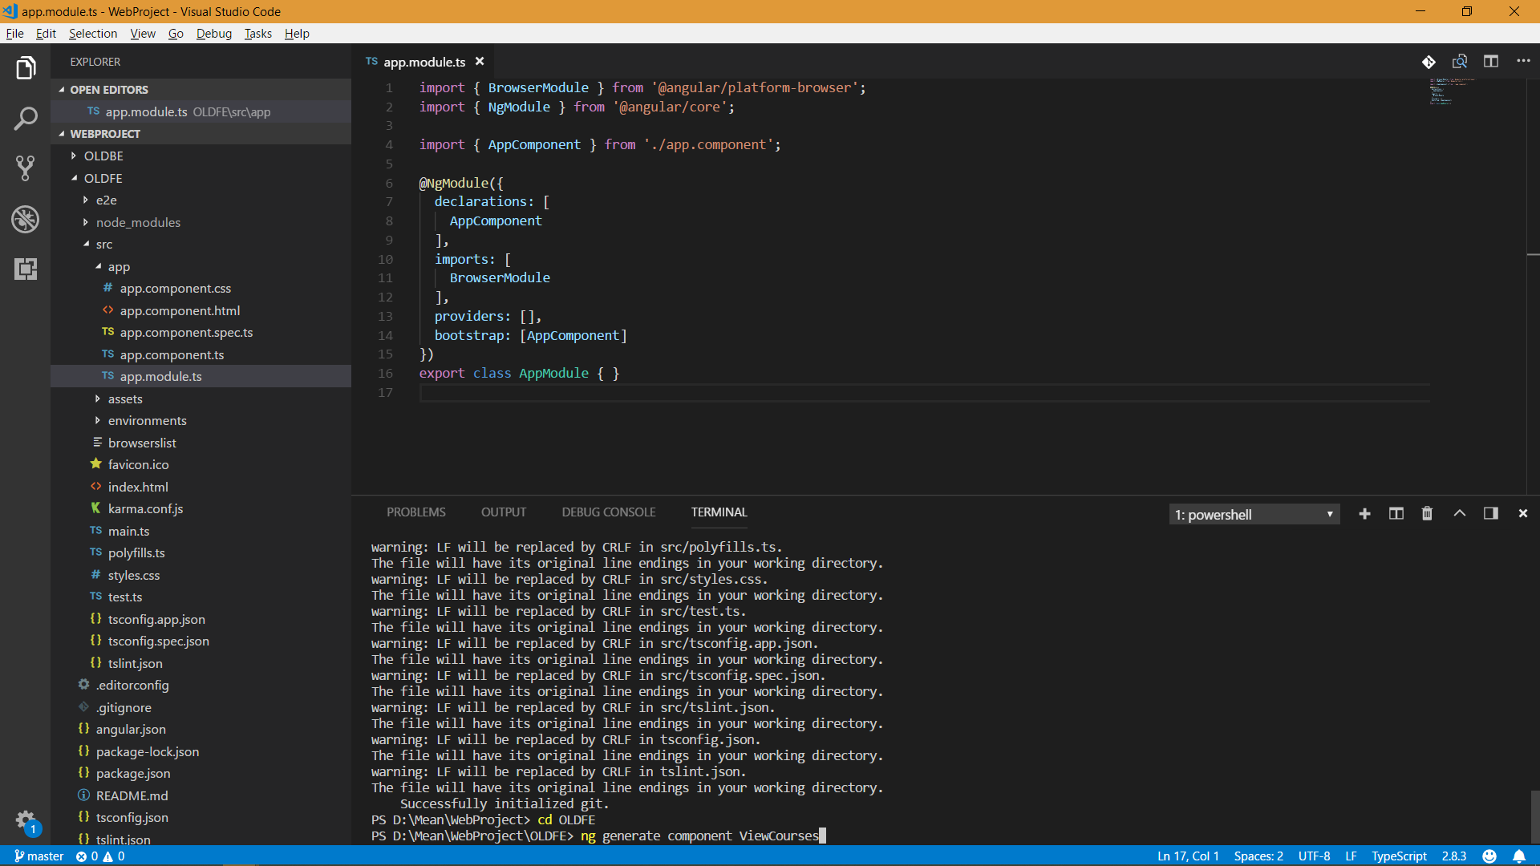
Notes:
Generate Component for View

Slide 35
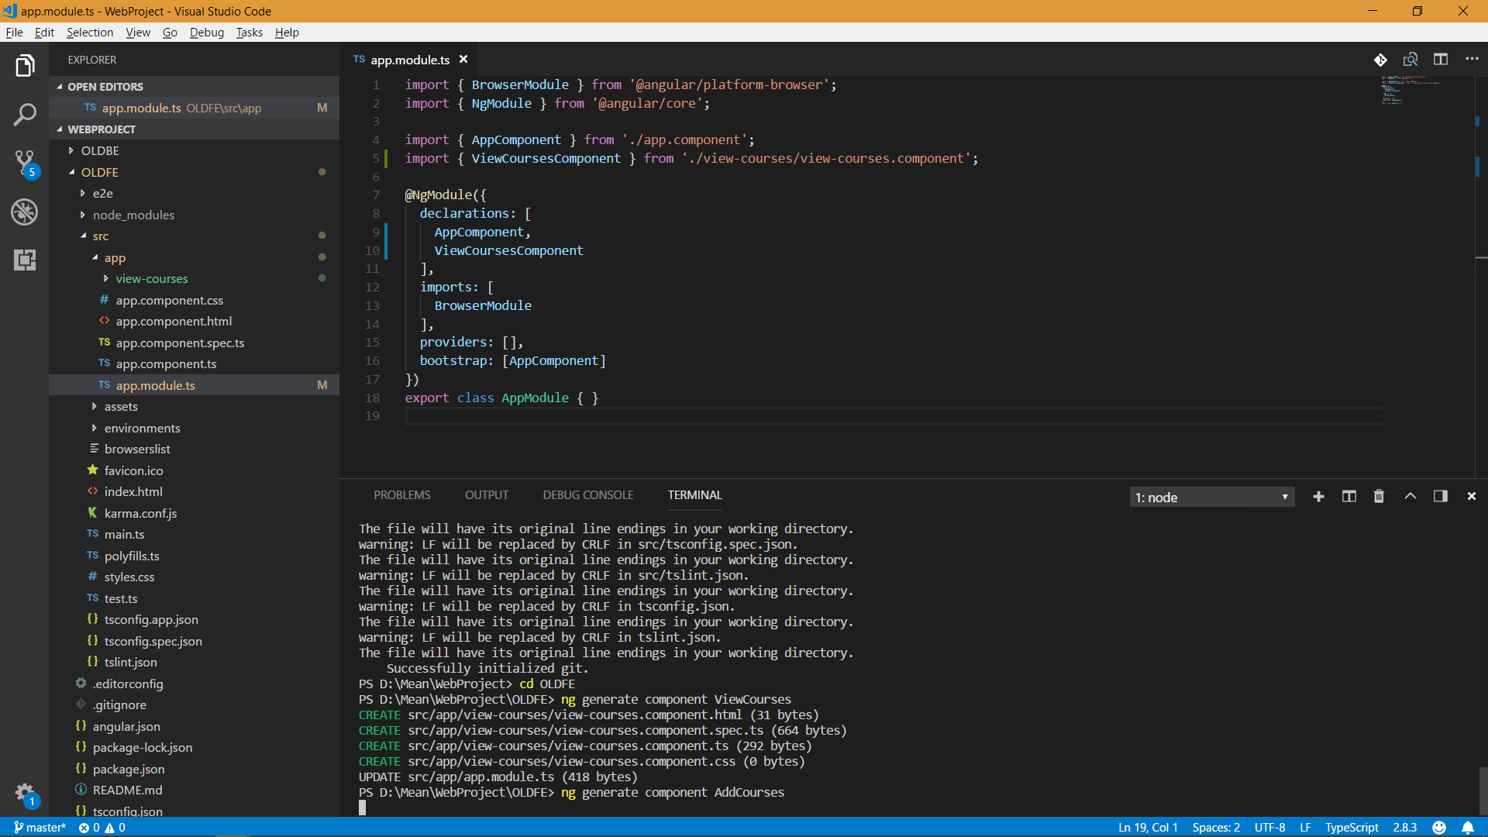
Notes:
Generate Component for create

Slide 36
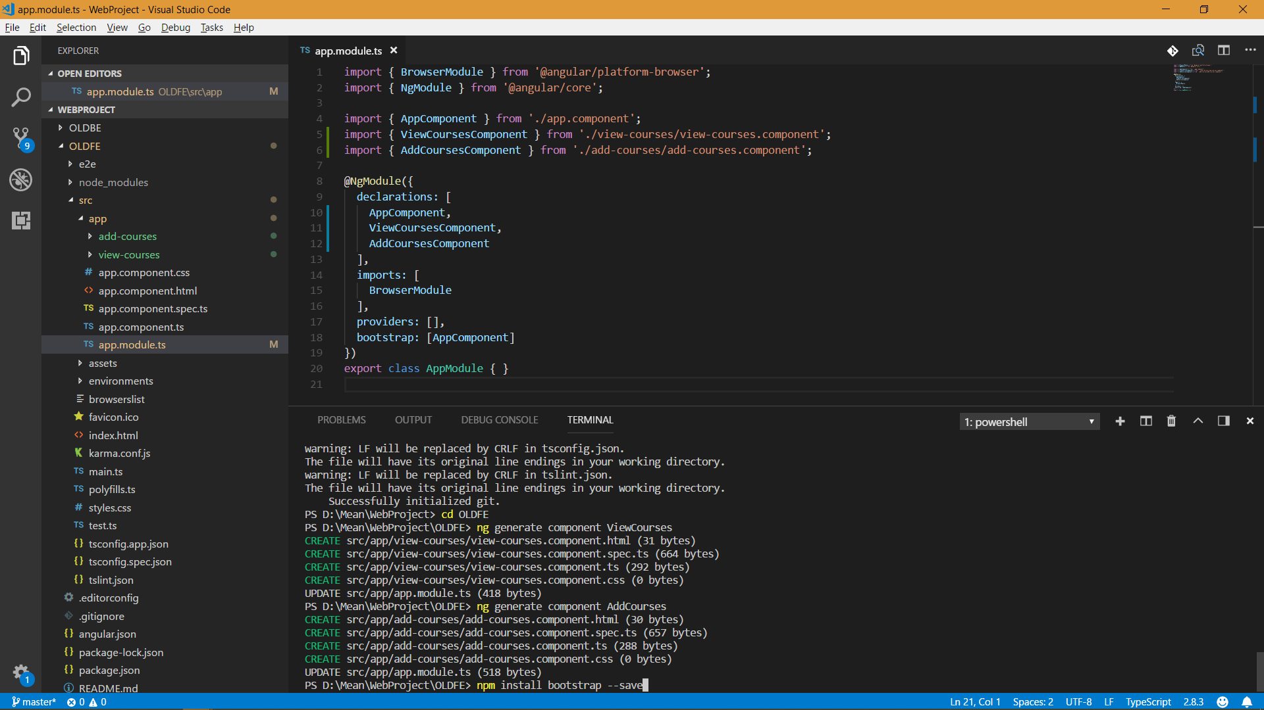
Notes:
Install bootstrap

Slide 37
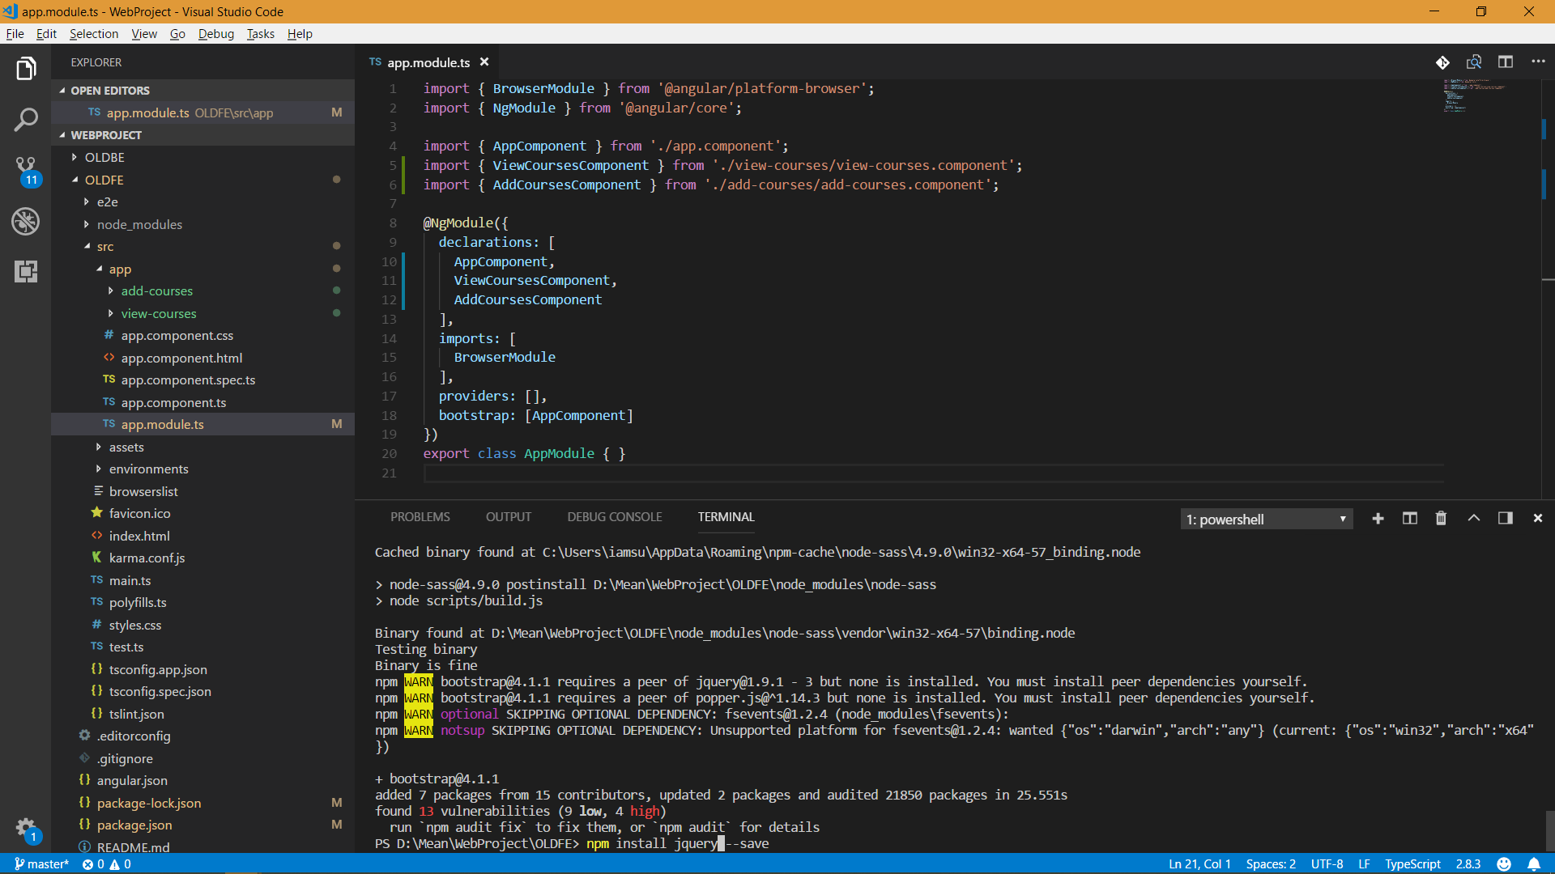
Notes:
Install Jquery

Slide 38
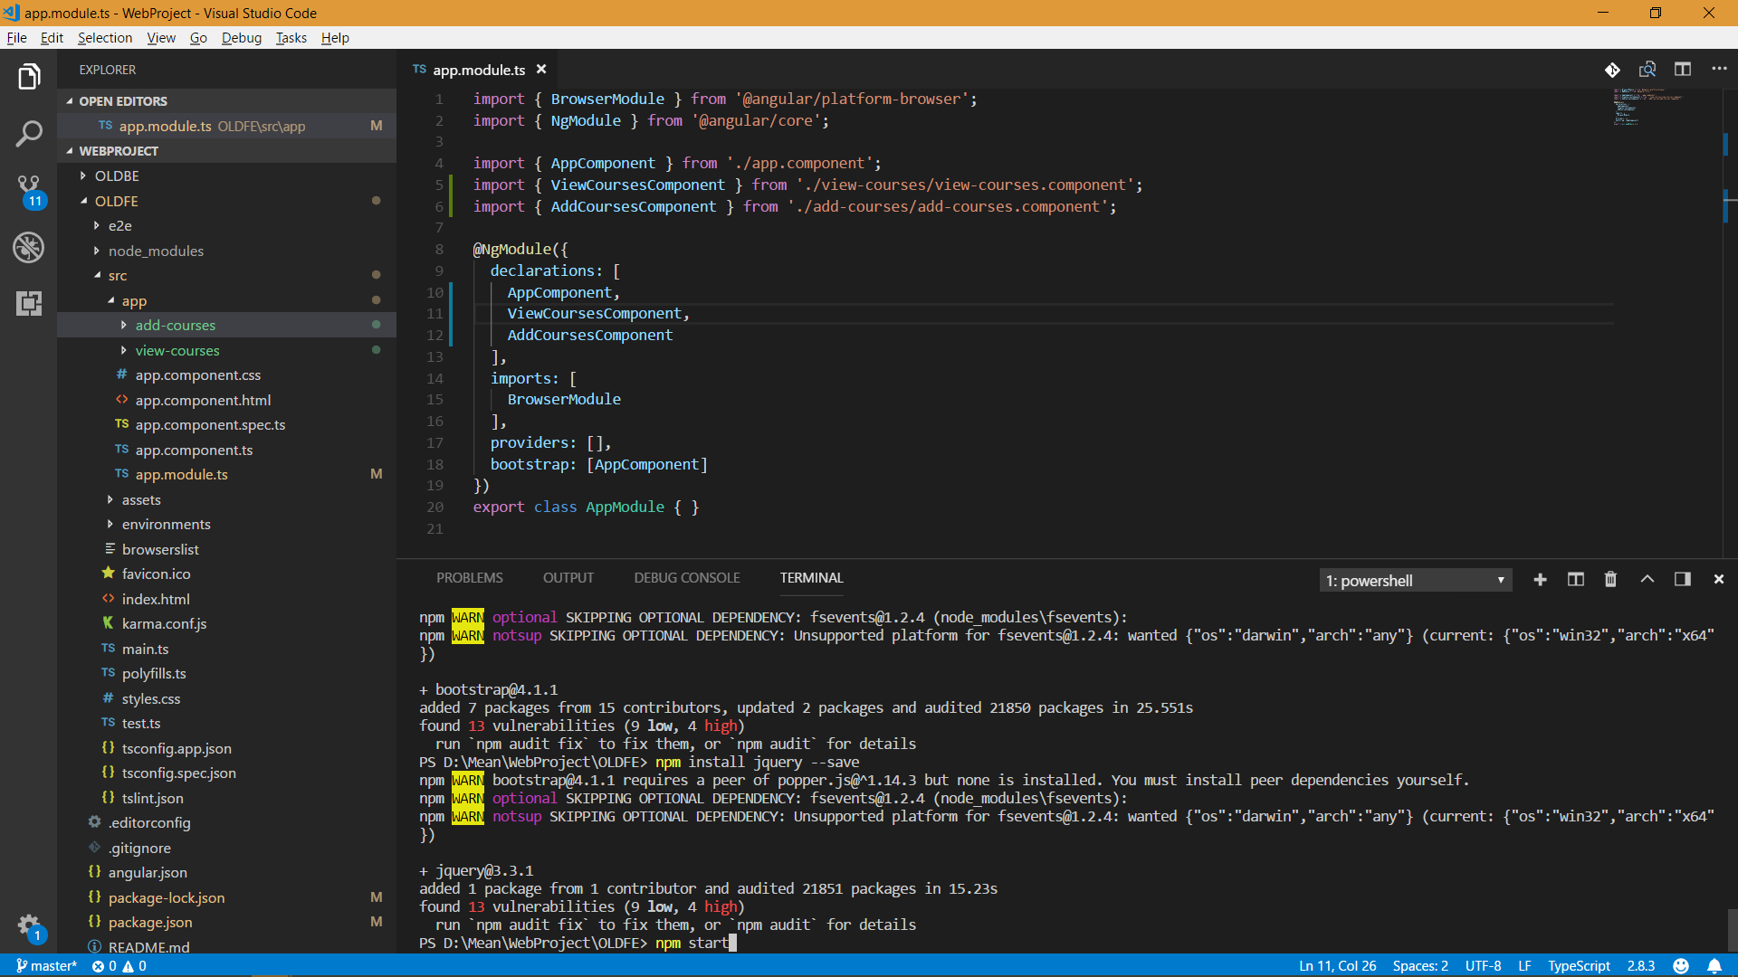
Notes:
Start App

Slide 39
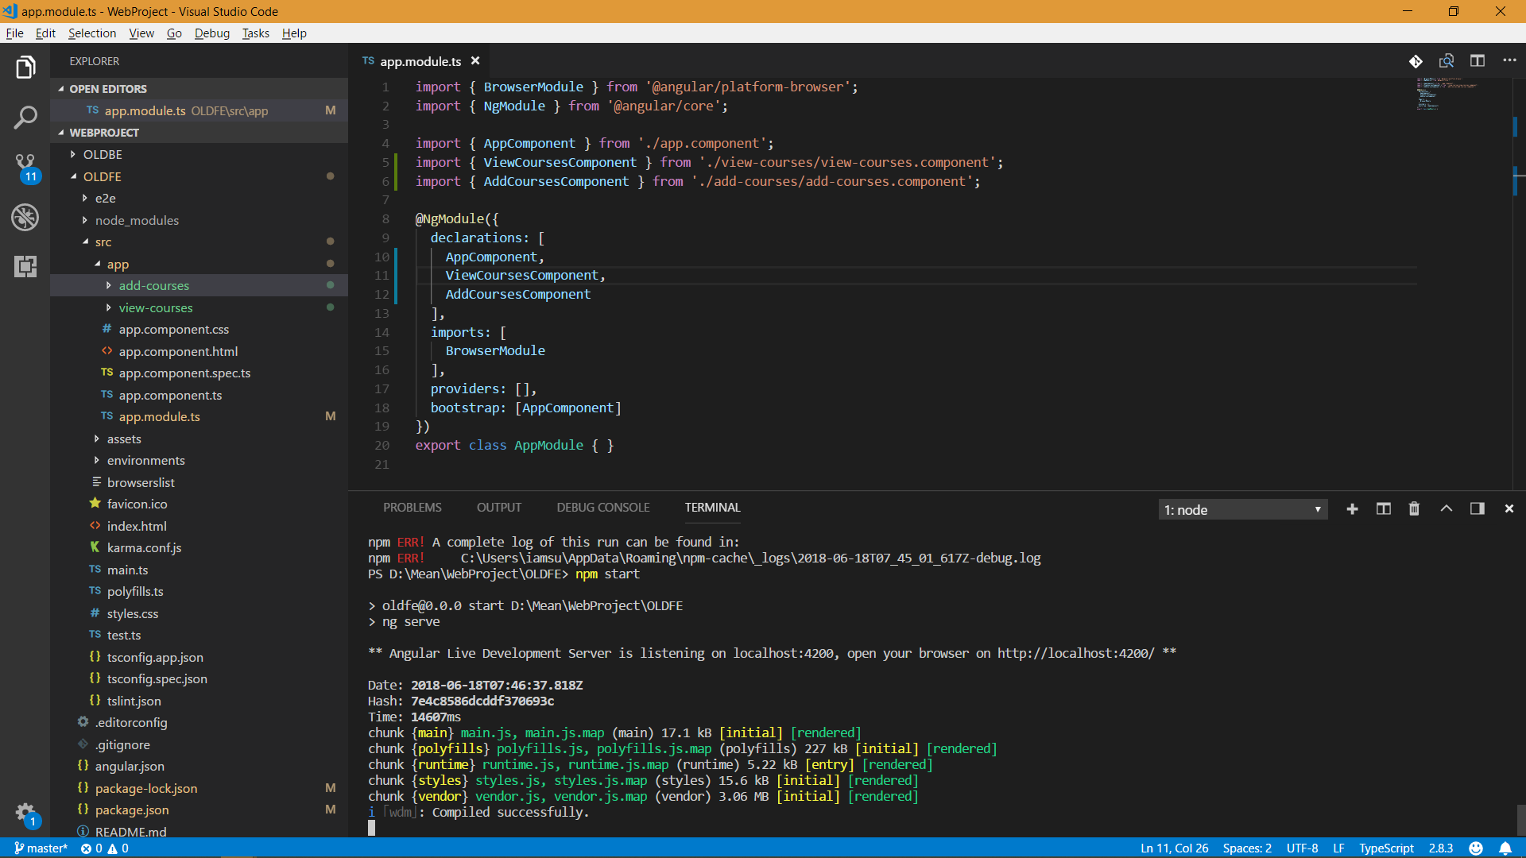

Slide 40
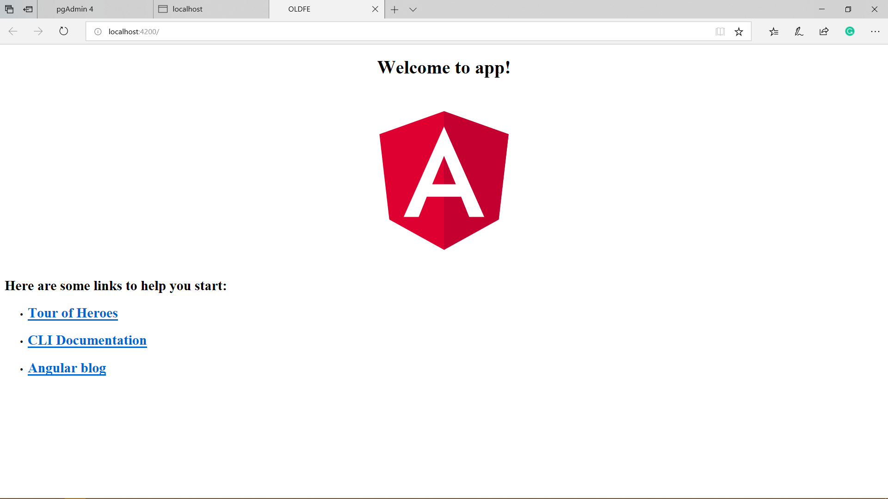
Notes:
This gives default page

Slide 41
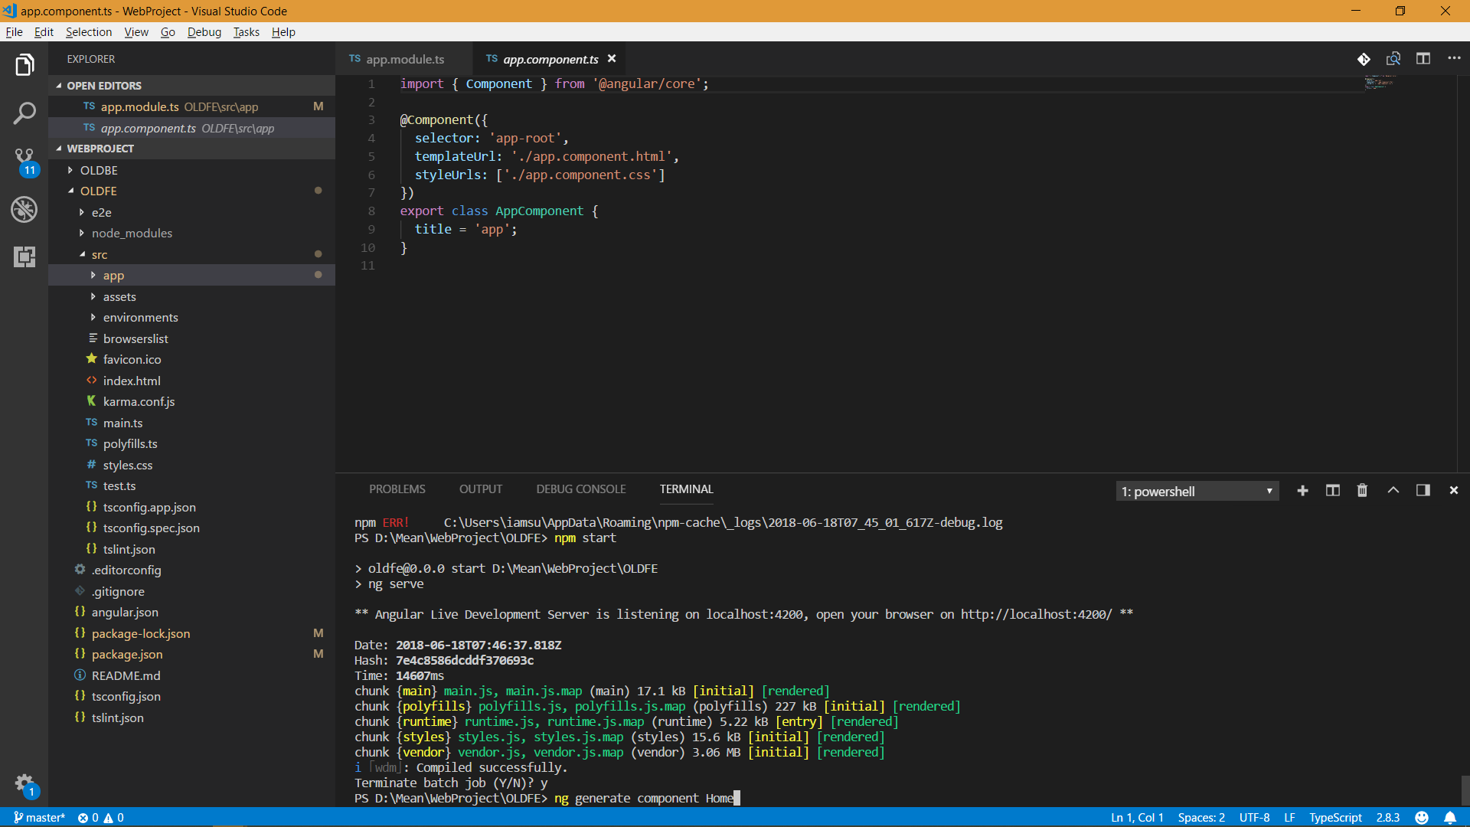
Notes:
Create home view

Slide 42
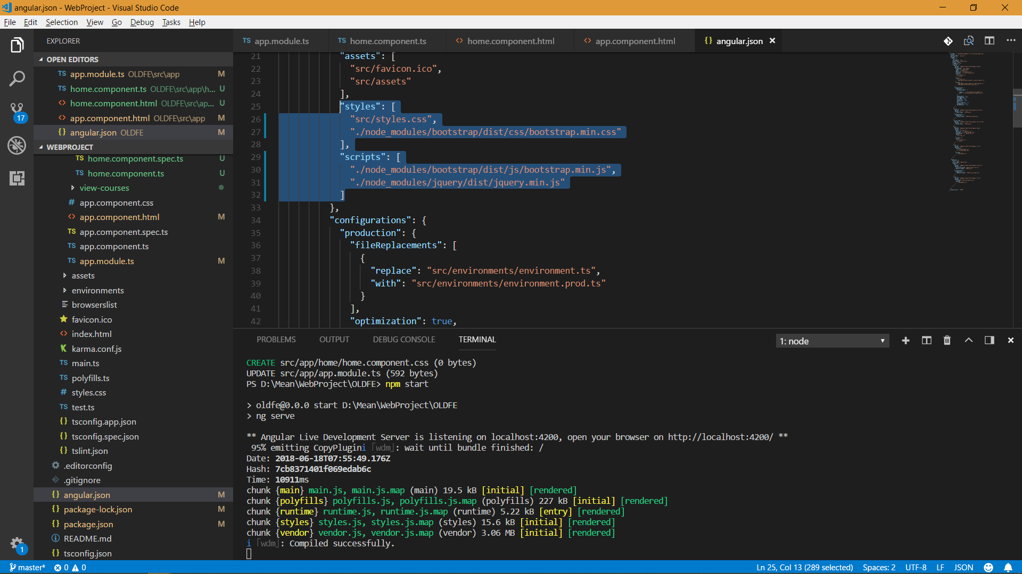
Notes:
Add Styles and script in angular.json

Slide 43
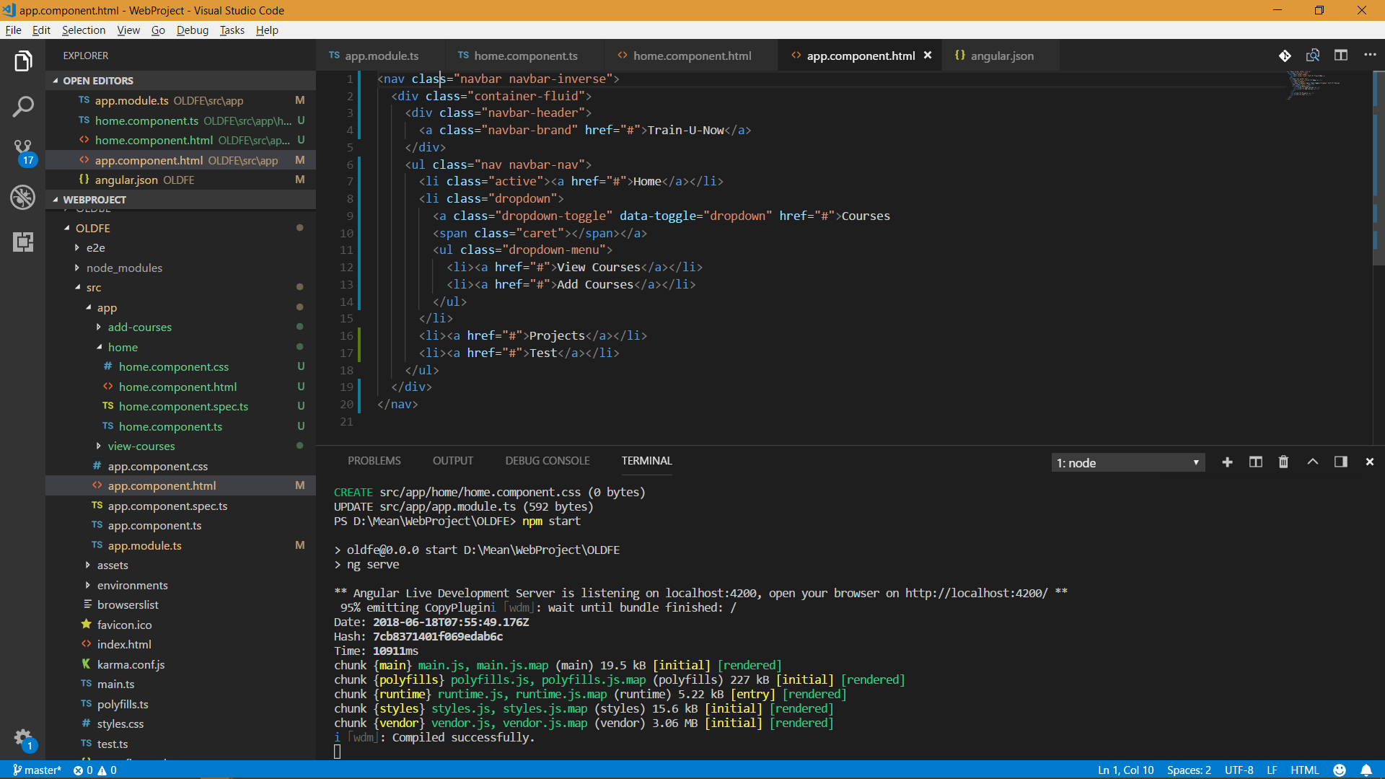
Notes:
Add Navigator

Slide 44
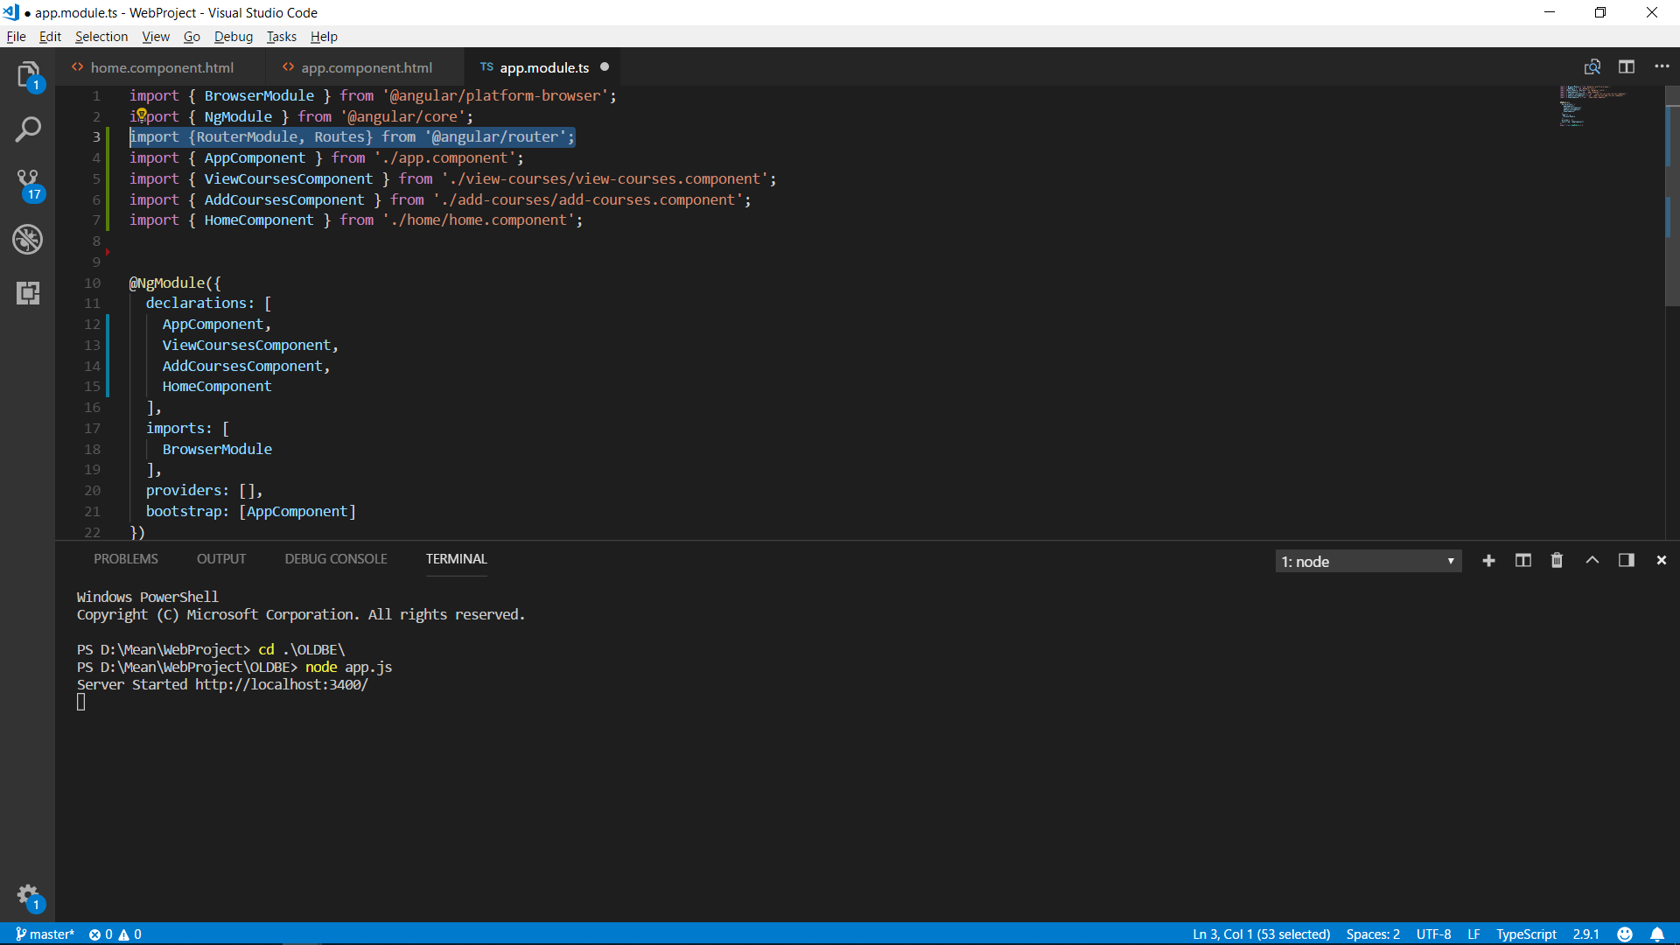

Slide 45
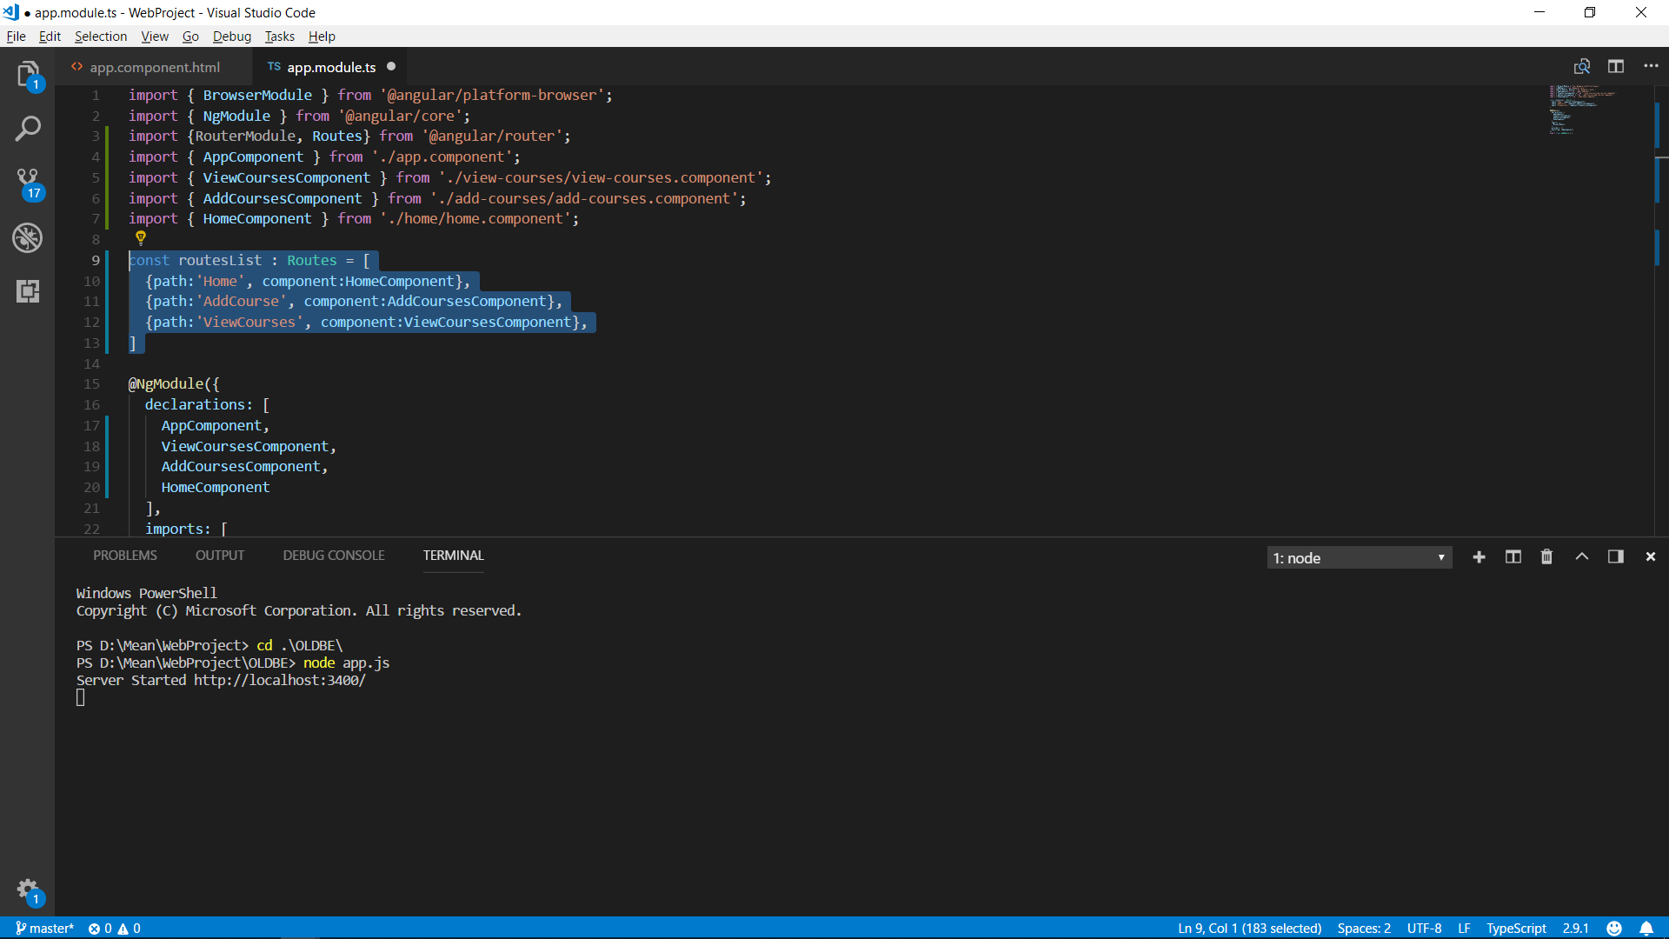

Slide 46
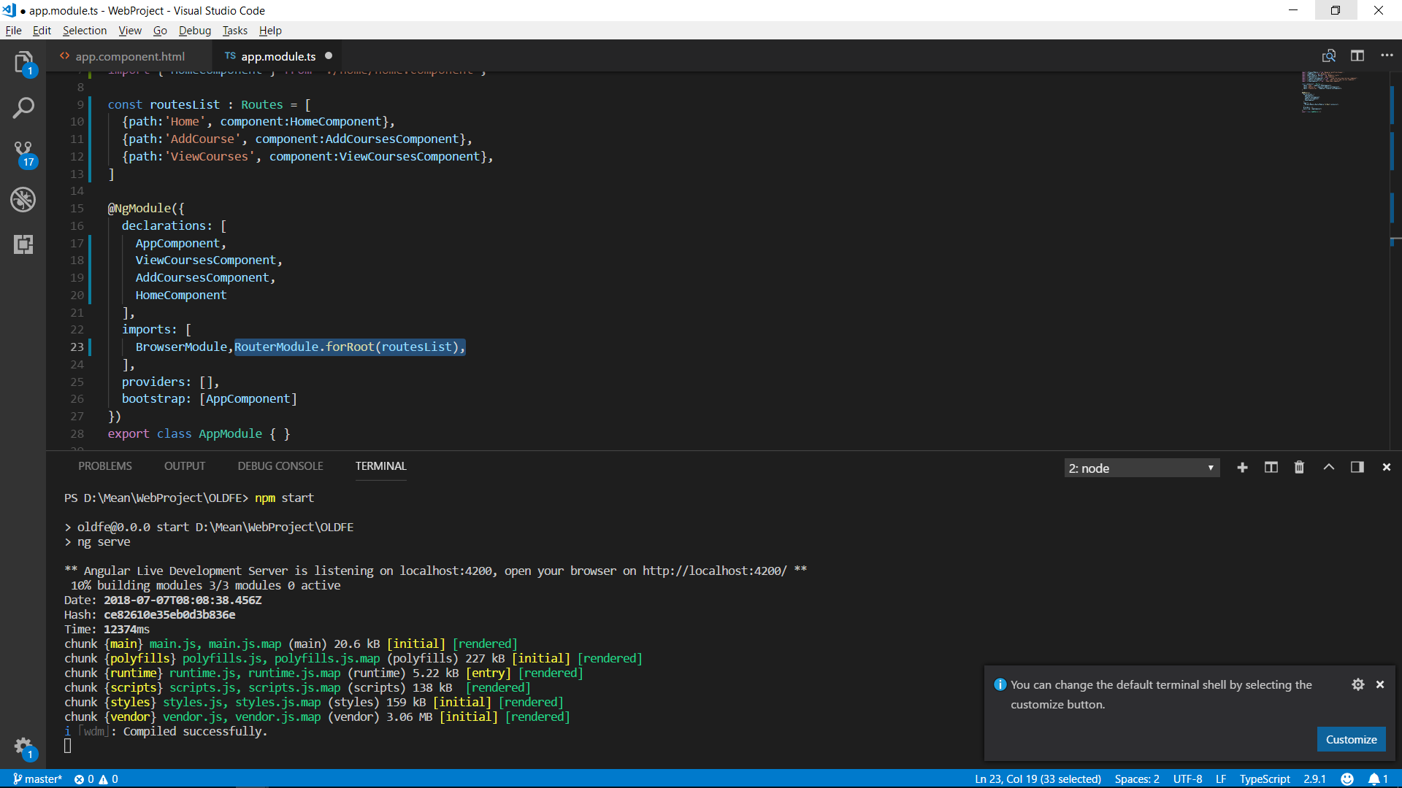
Notes:
Add route module

Slide 47
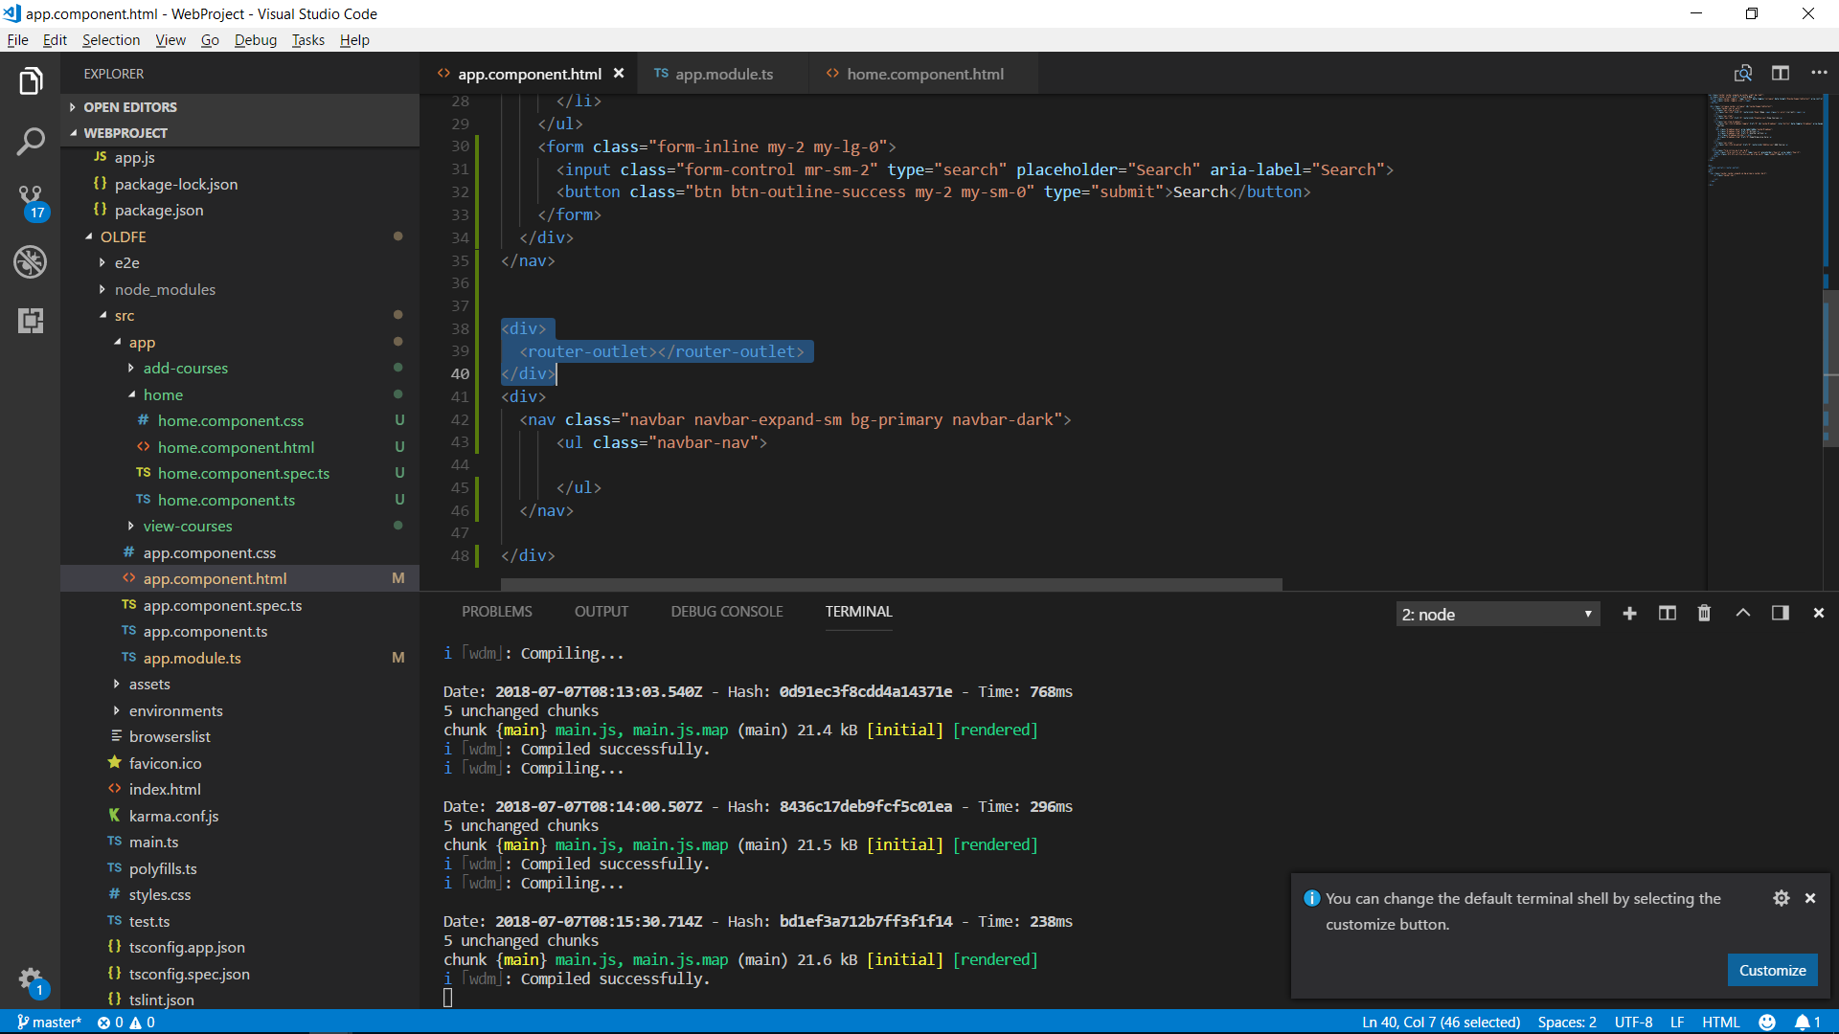

Slide 48
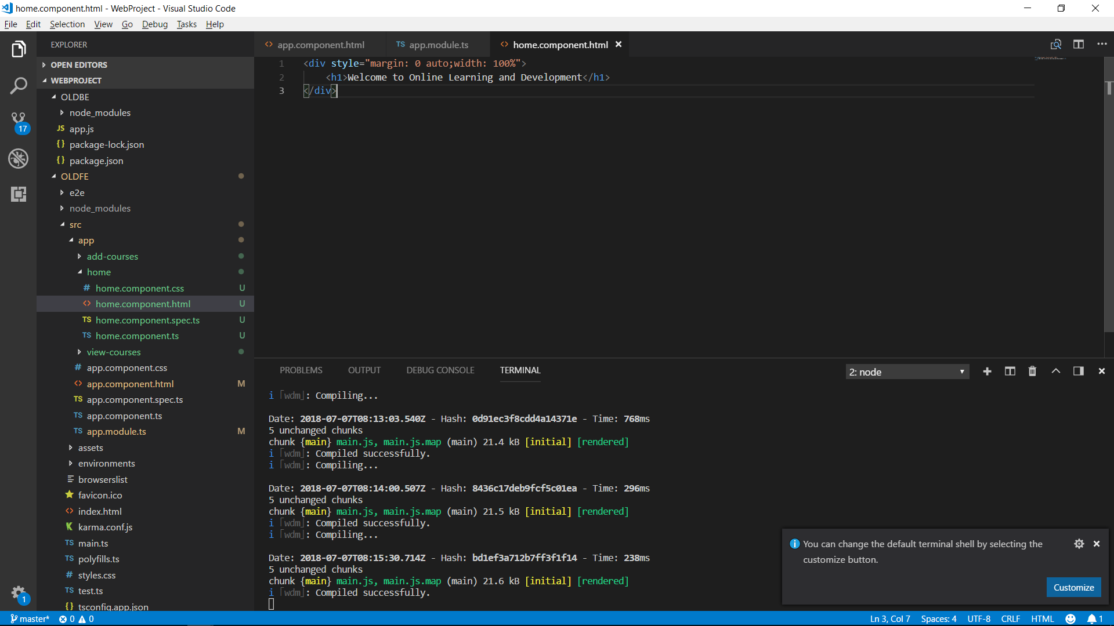

Slide 49
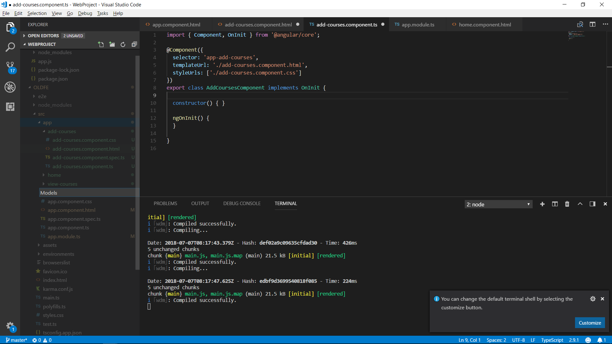

Slide 50


Slide 51
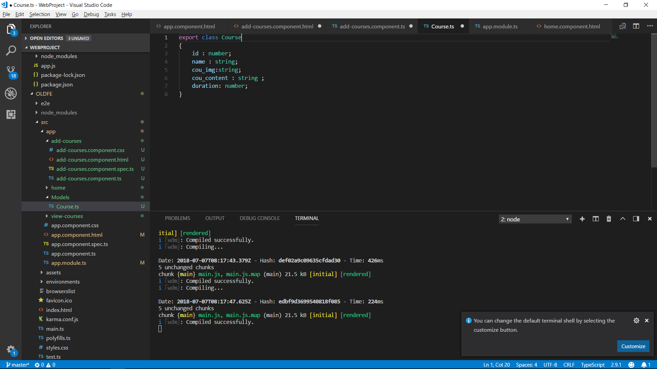

Slide 52
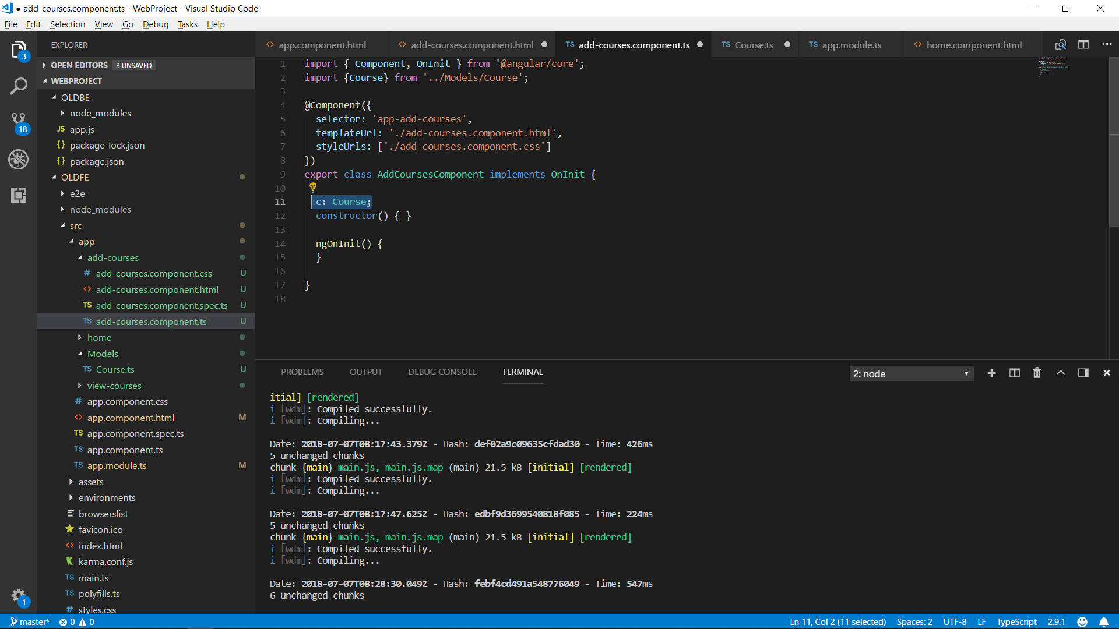

Slide 53
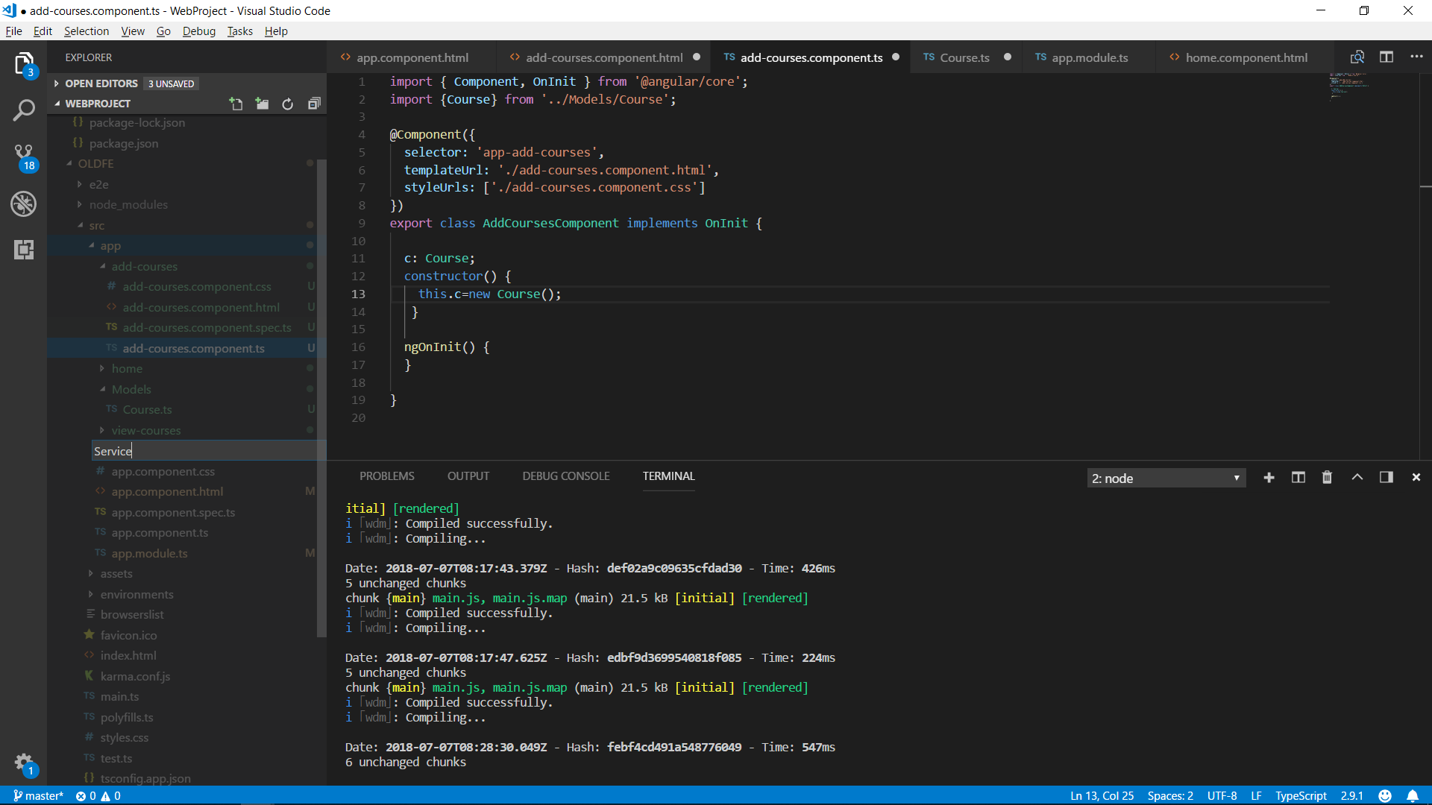

Slide 54
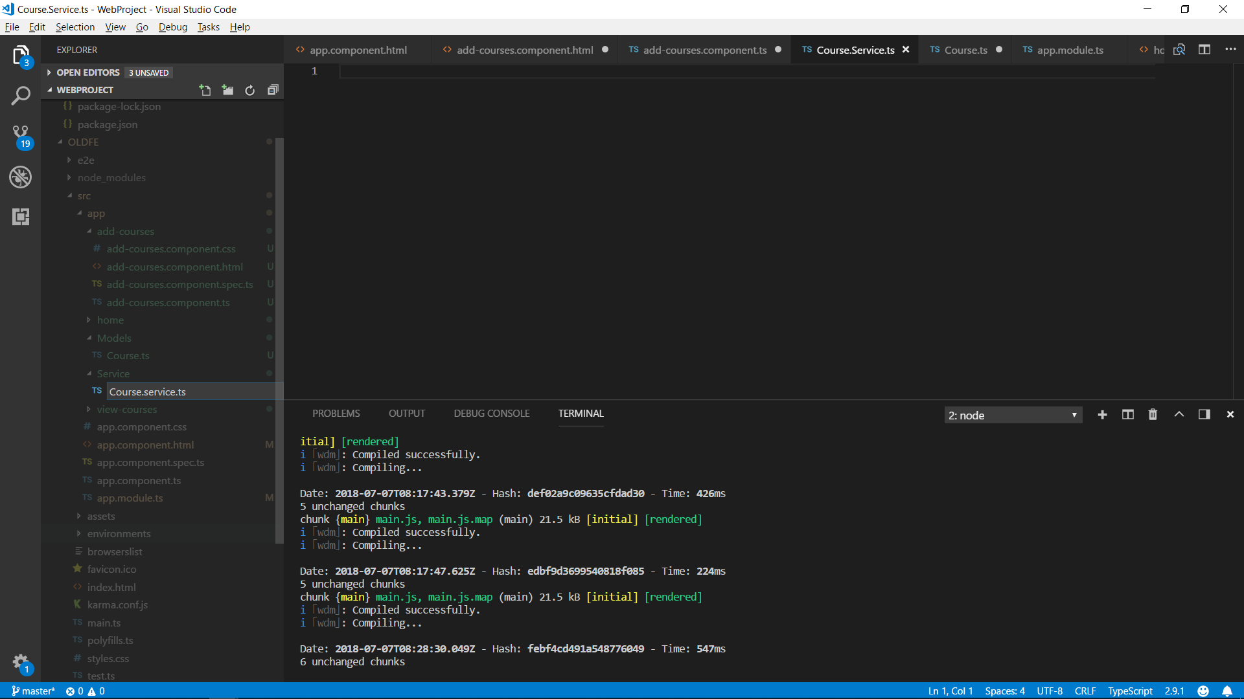

Slide 55
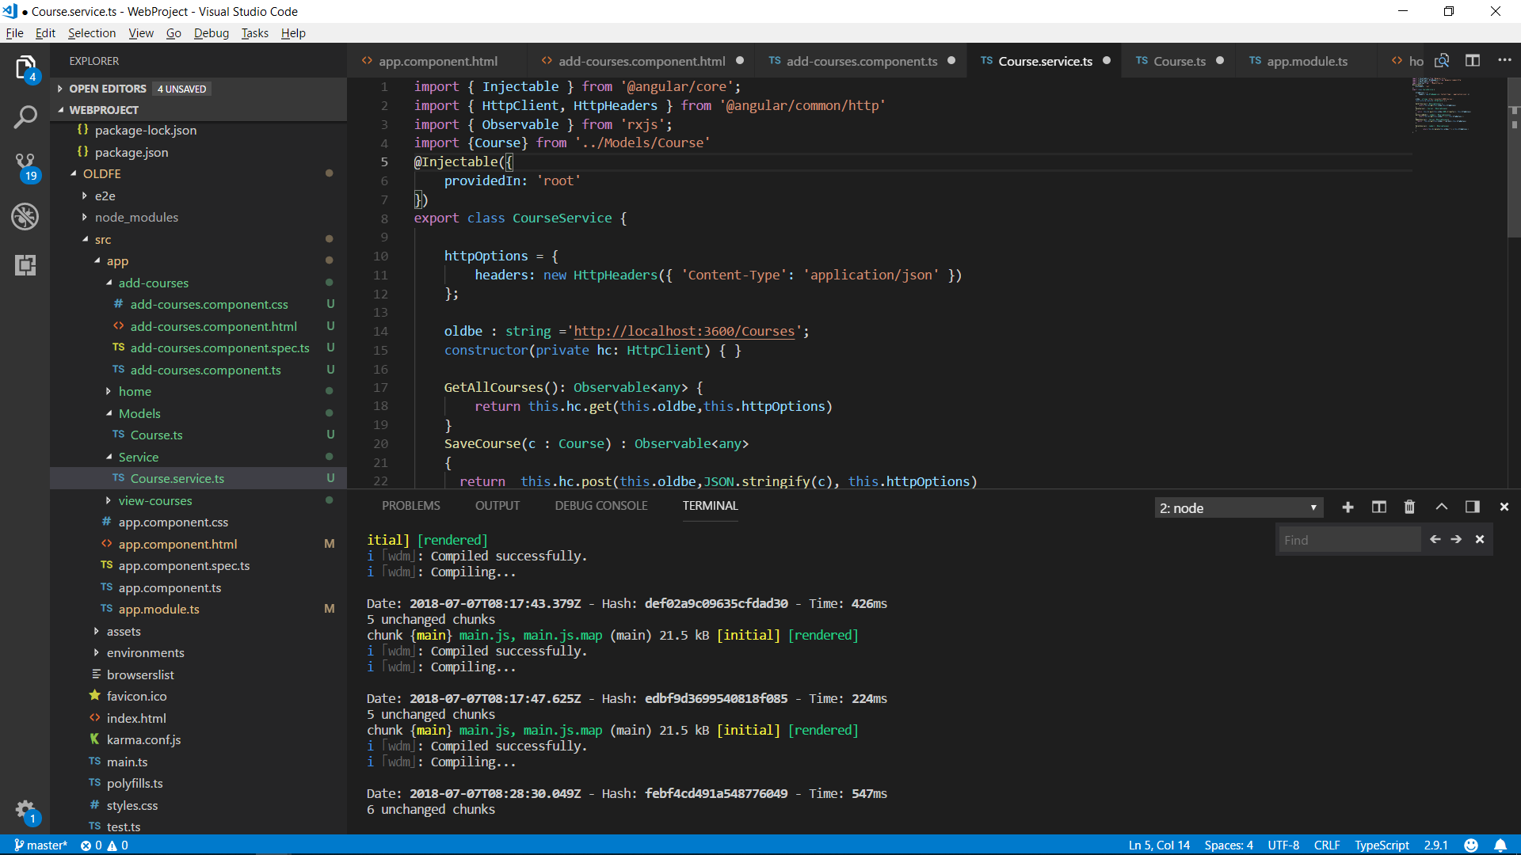

Slide 56
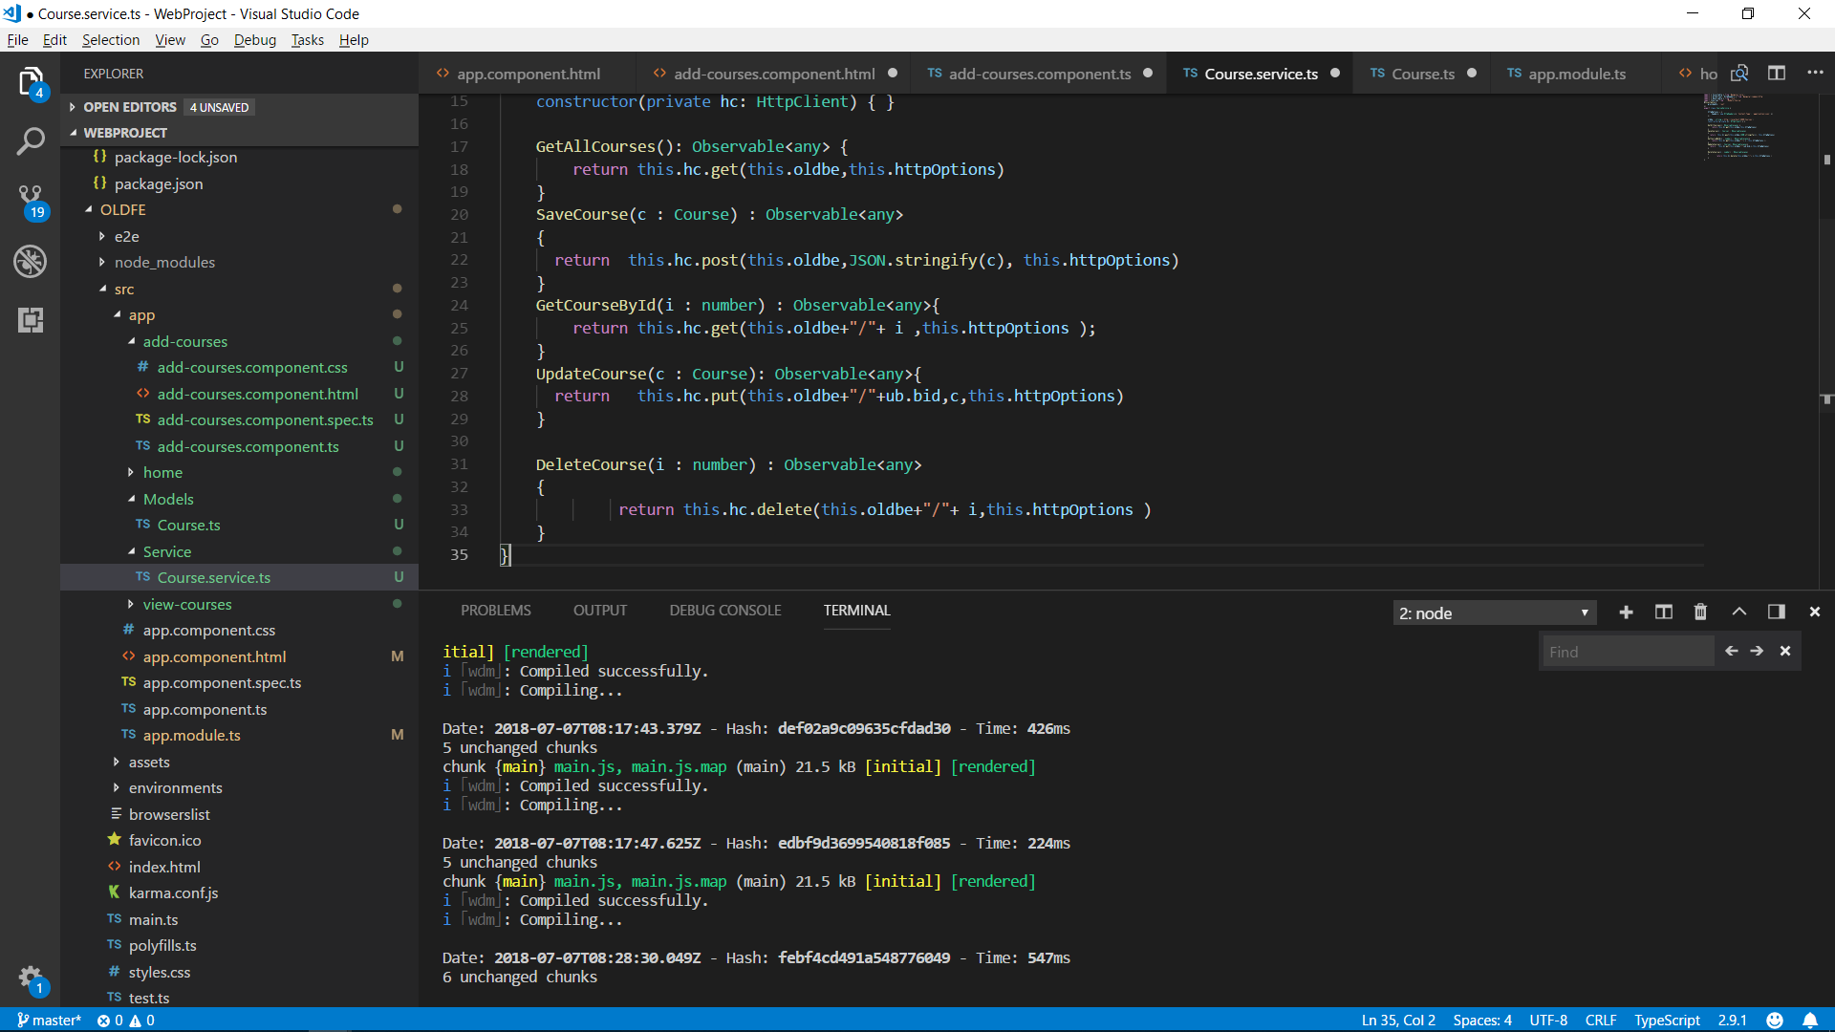

Slide 57
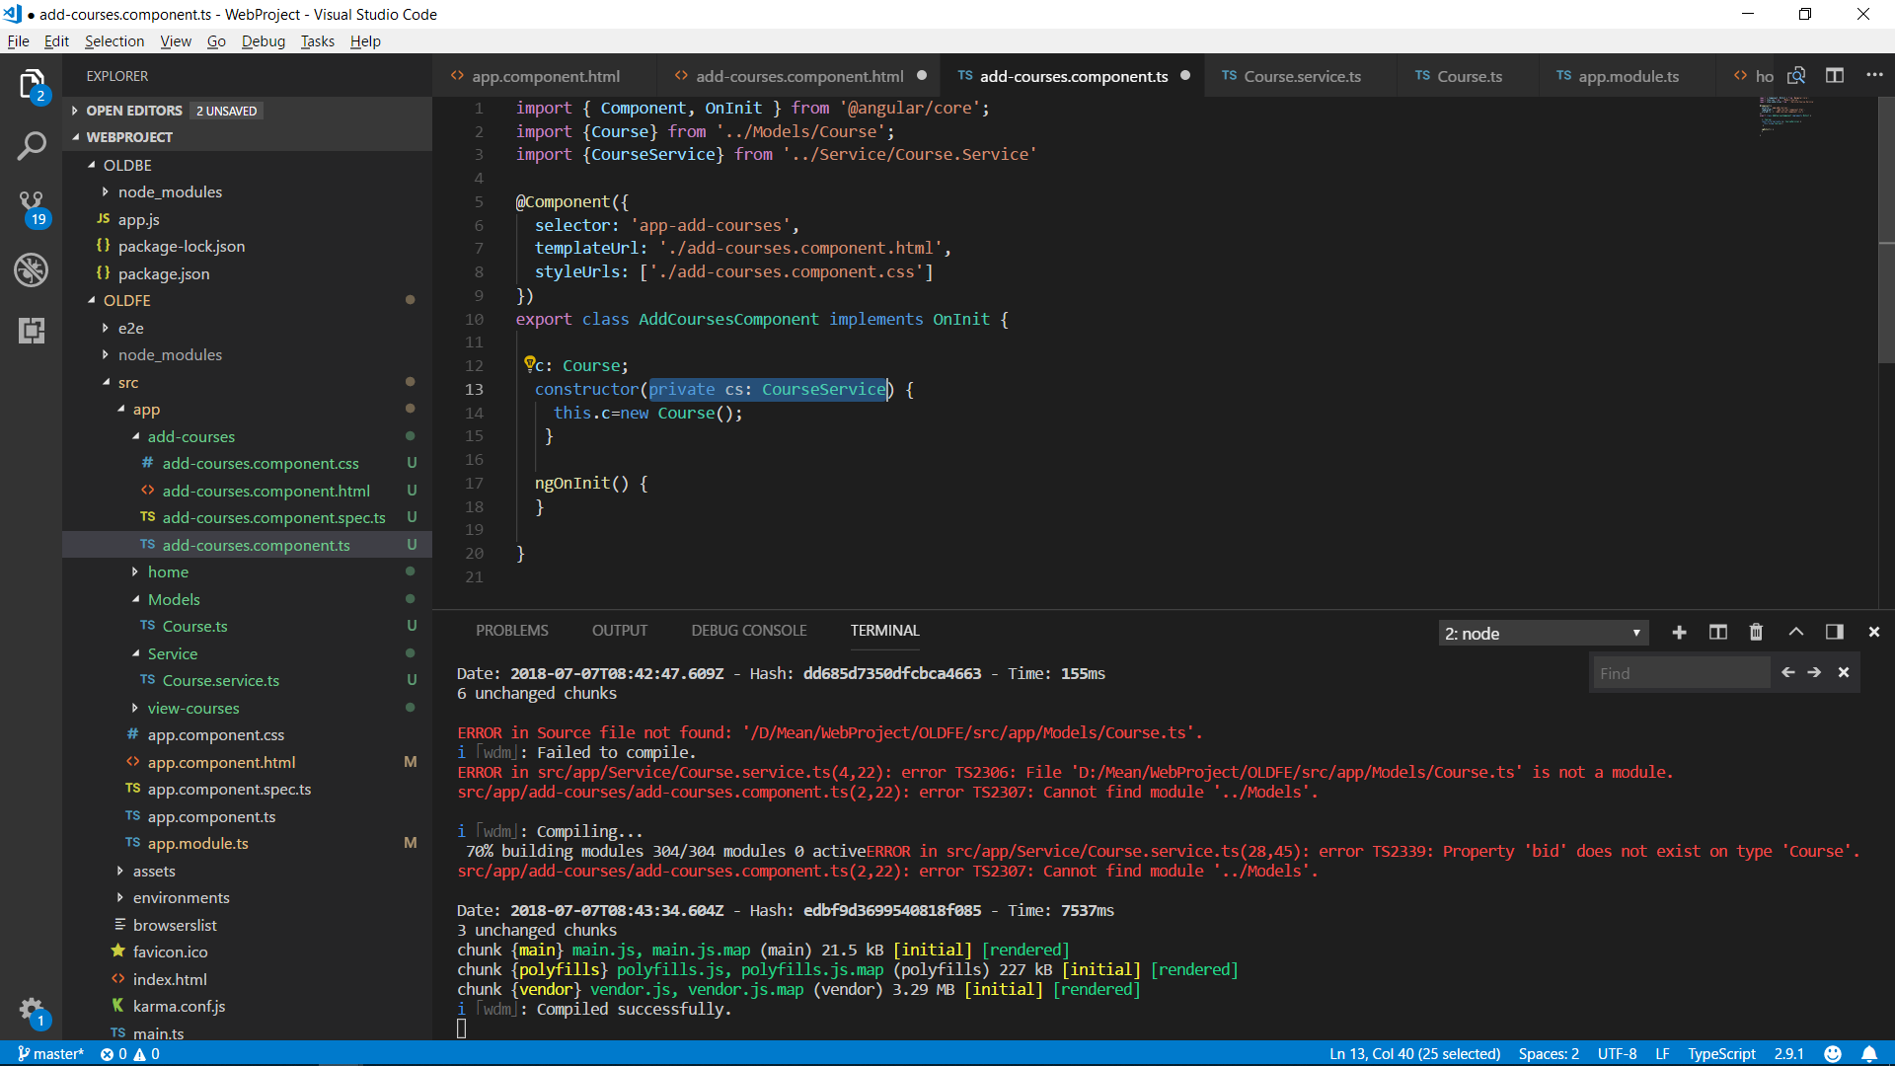

Slide 58


Slide 59


